Slide 1
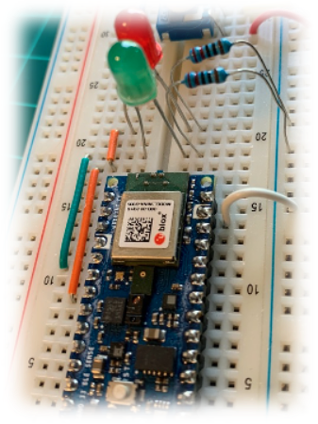

IESTI01 – TinyML
Embedded
Machine Learning
KeyWord Spotting (KWS) Introduction
Prof. Marcelo Rovai
UNIFEI

Slide 2
What is KeyWord Spotting?

Slide 3
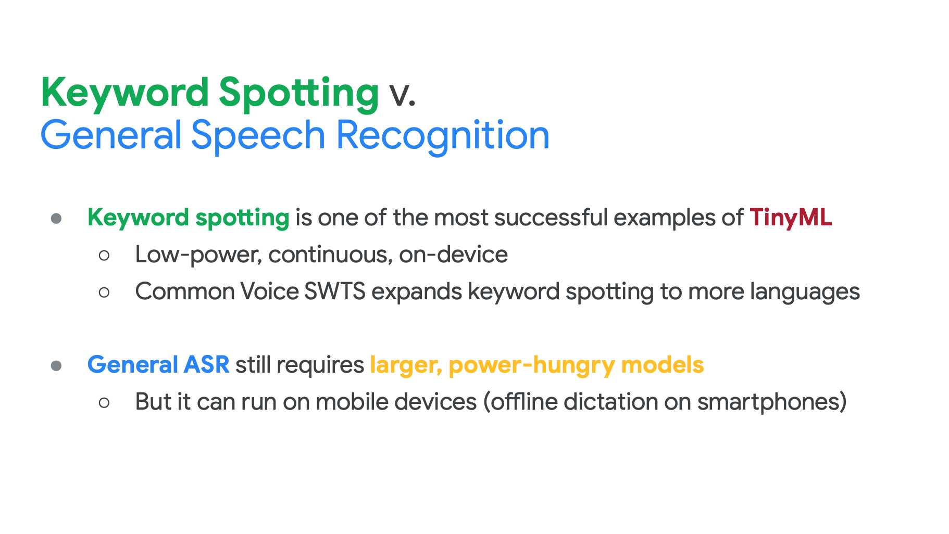
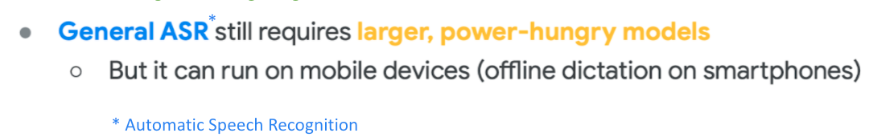

*
* Single Word Target Segment
*
* Automatic Speech Recognition

Slide 4
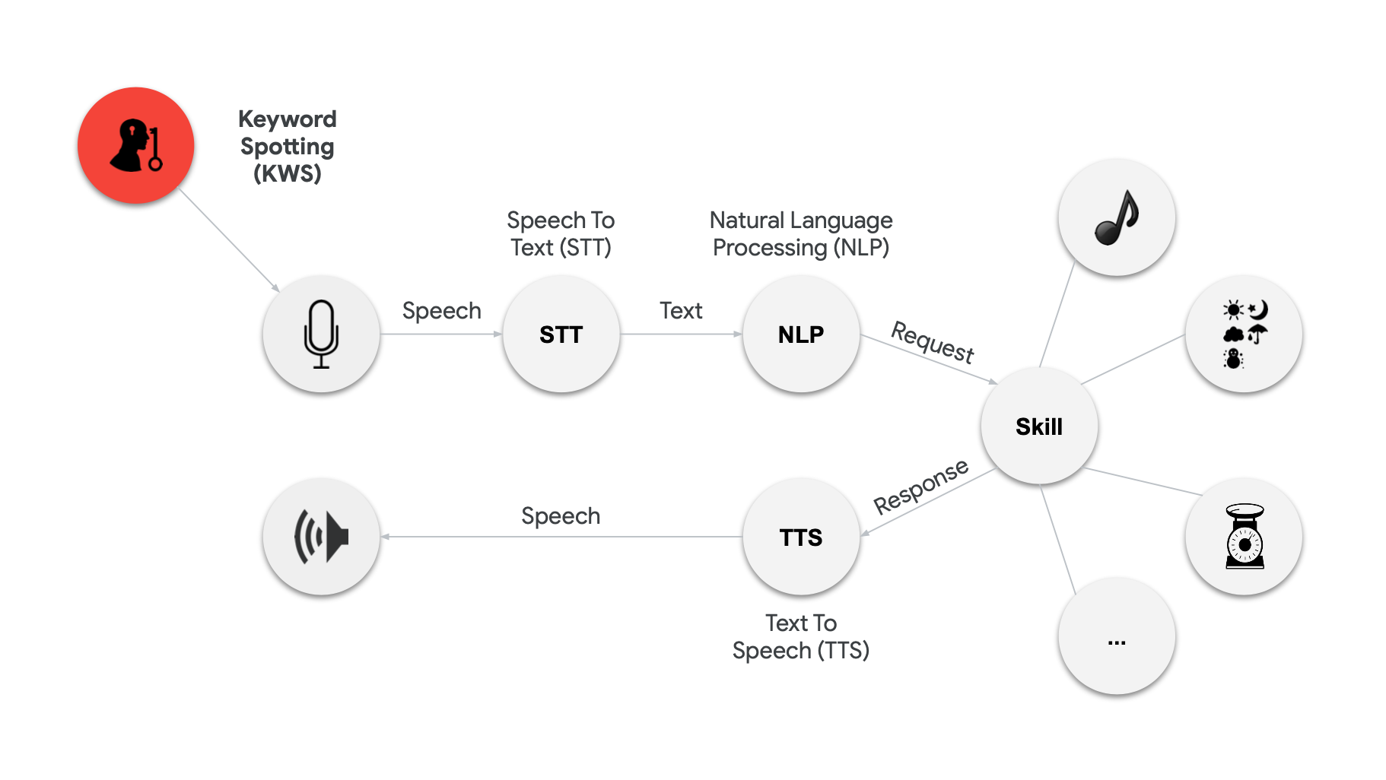

Slide 5
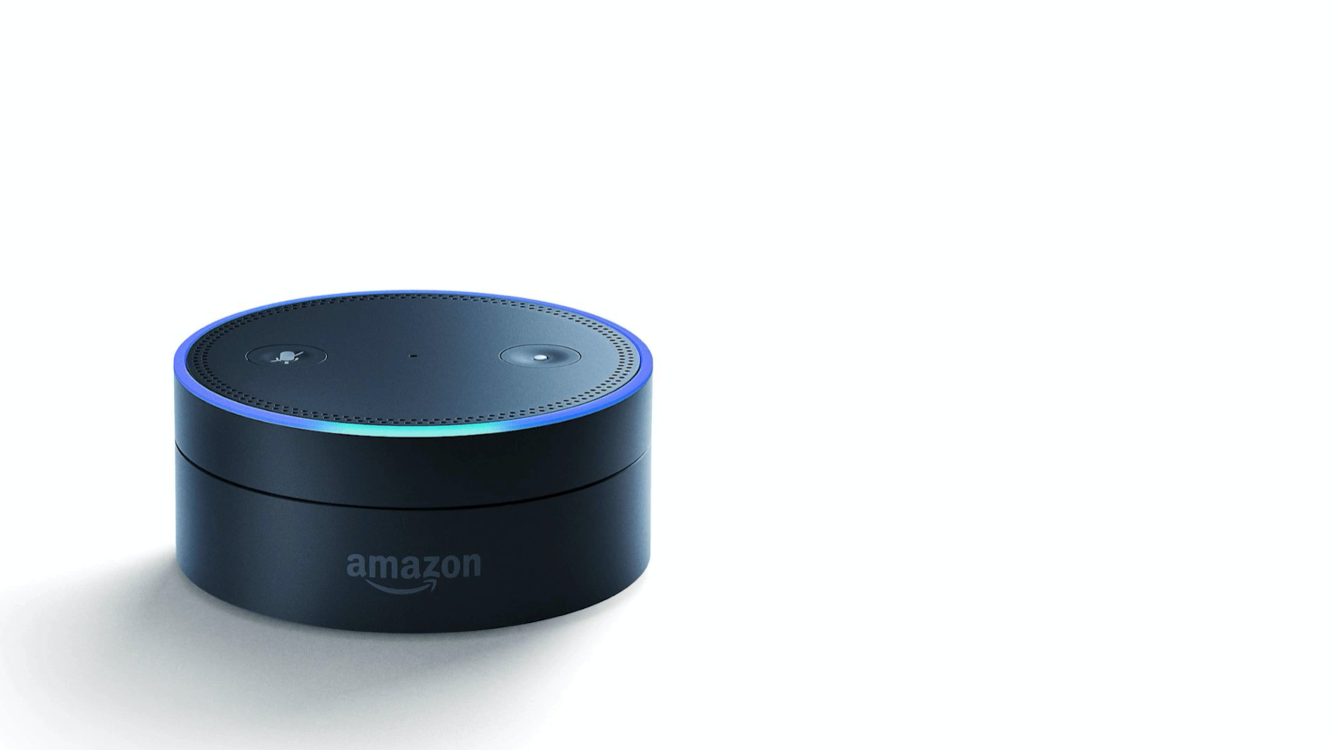

Slide 6


Slide 7
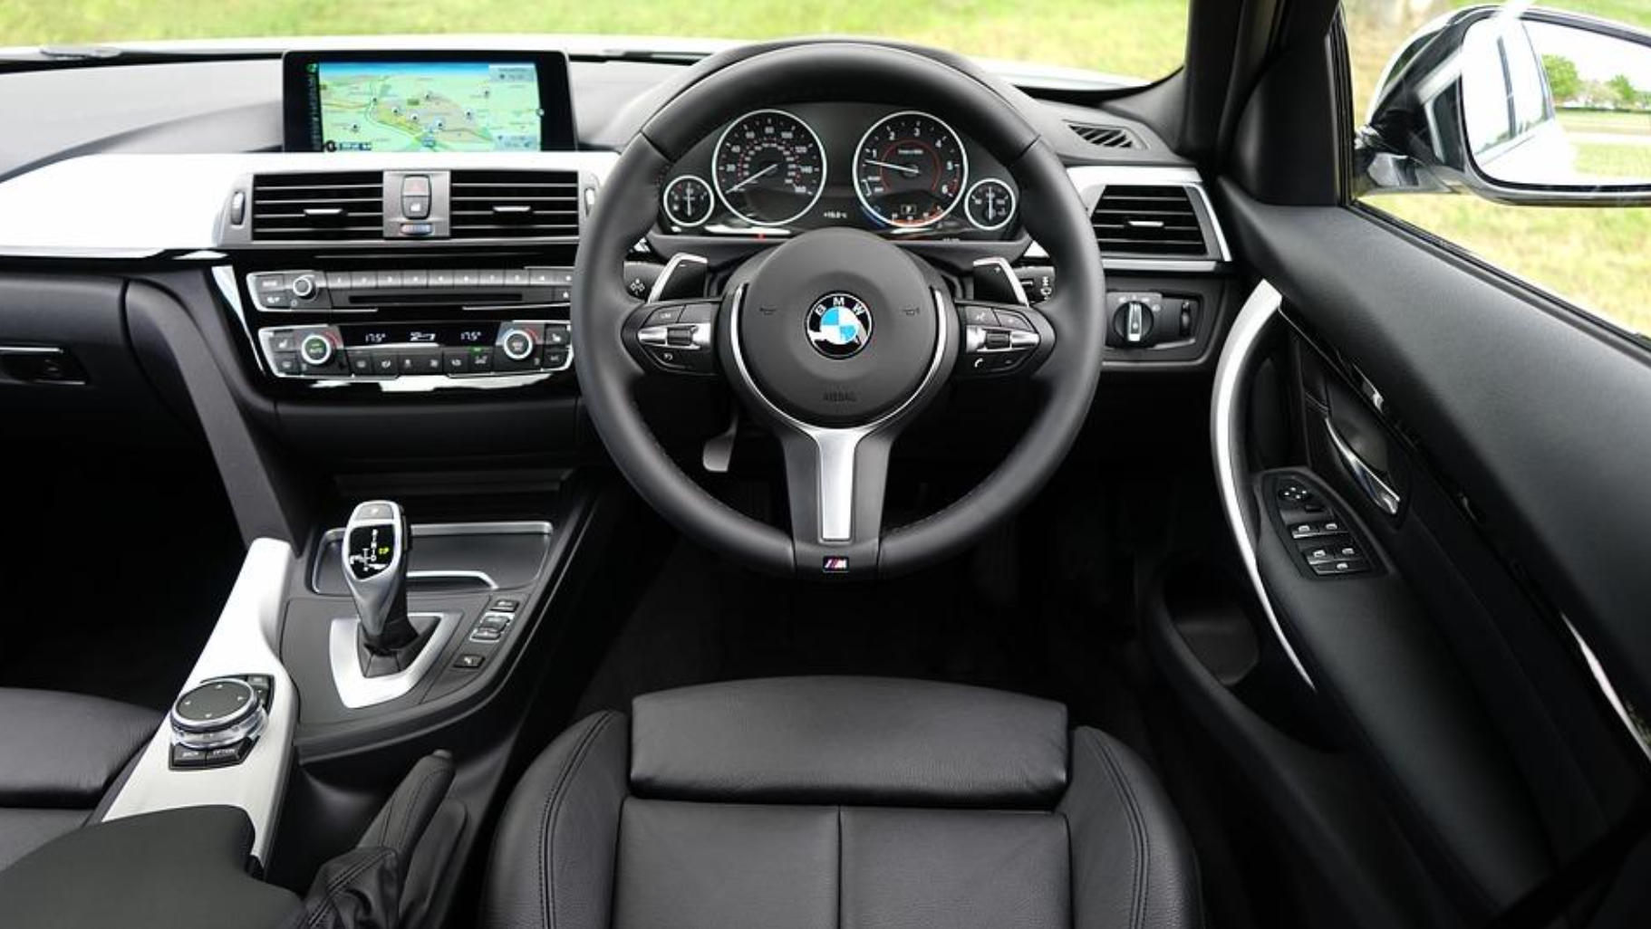

Slide 8
More than just voice
Secutity (Broken Glass)
Industry (Anomaly Detection)
Medical (Snore, Toss)
Nature (Bee, insect sound)

Slide 9
Keyword Spotting Challenges/Constrains

Slide 10
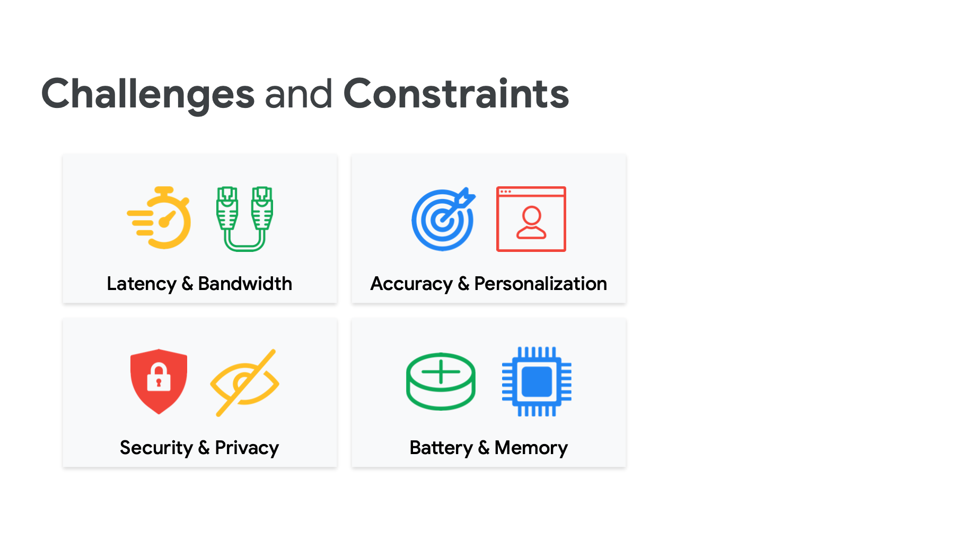

Slide 11
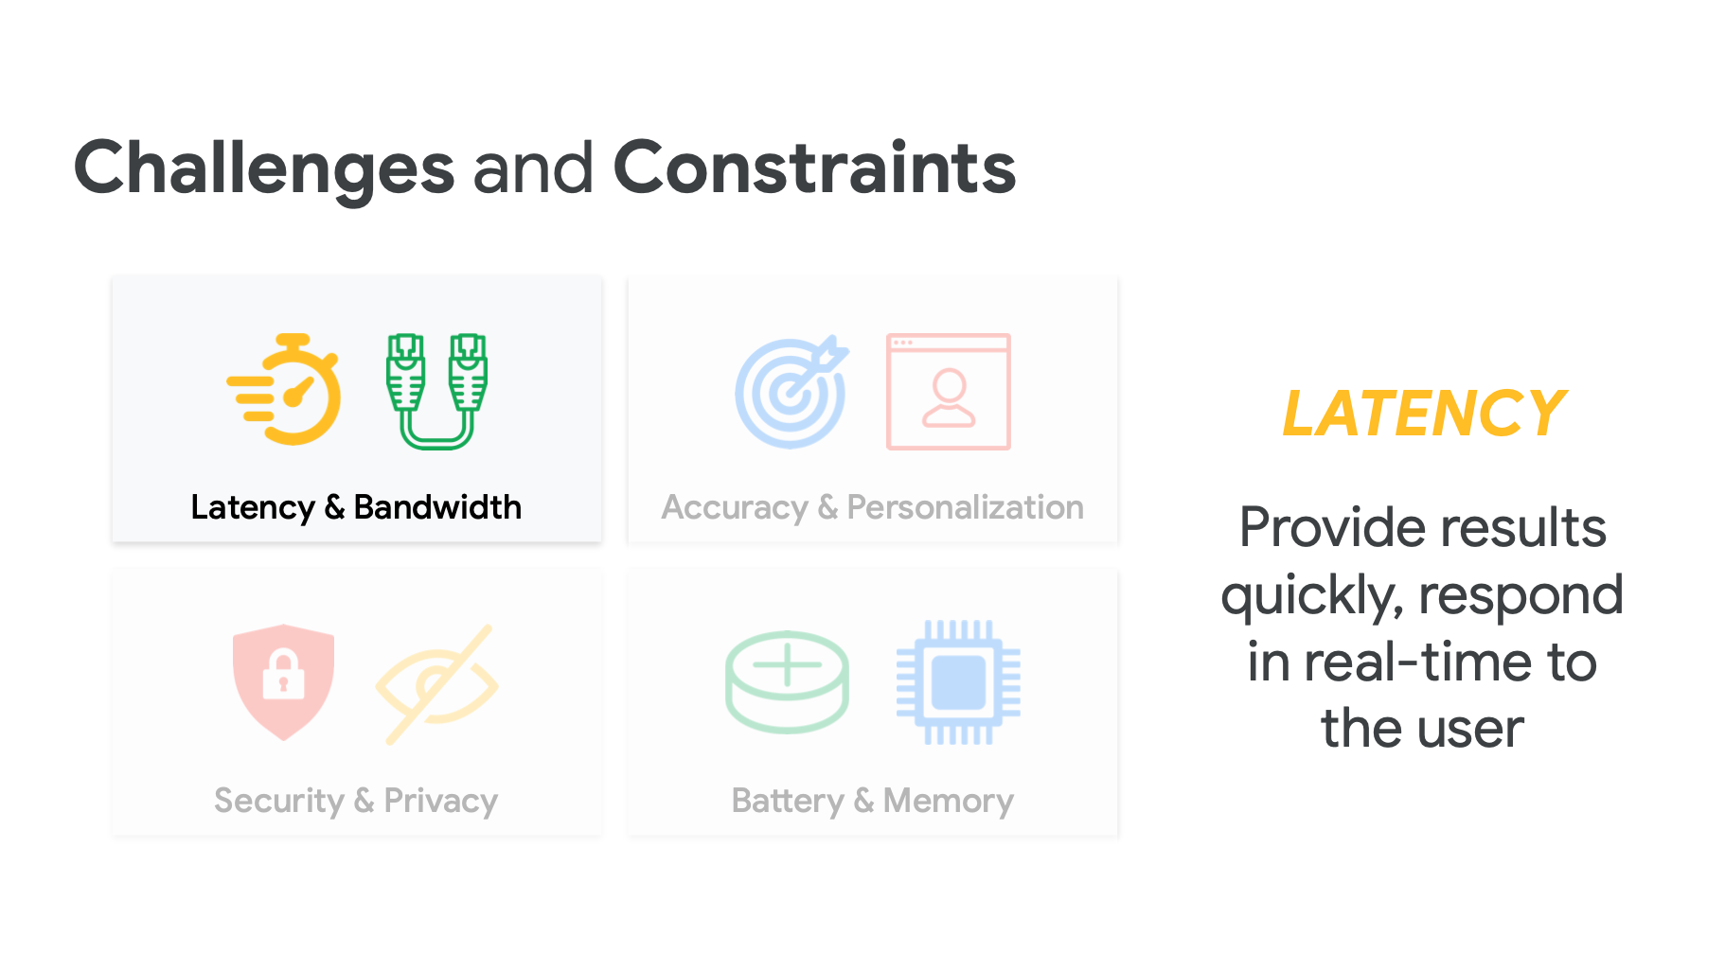

Slide 12
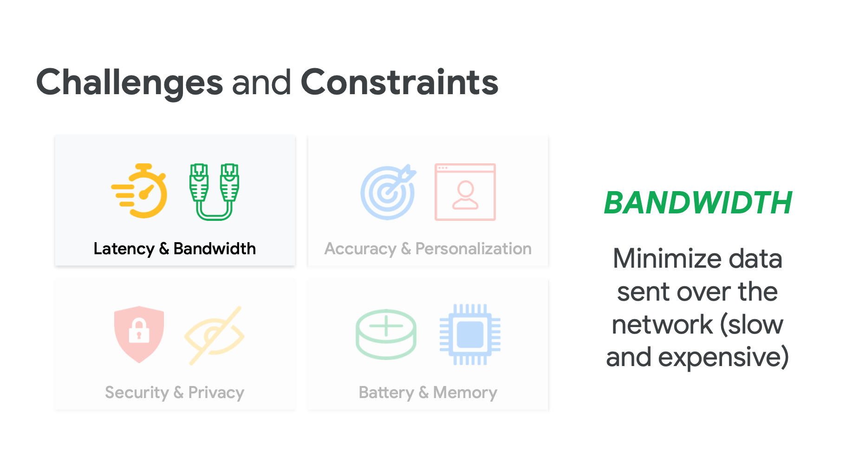

Slide 13
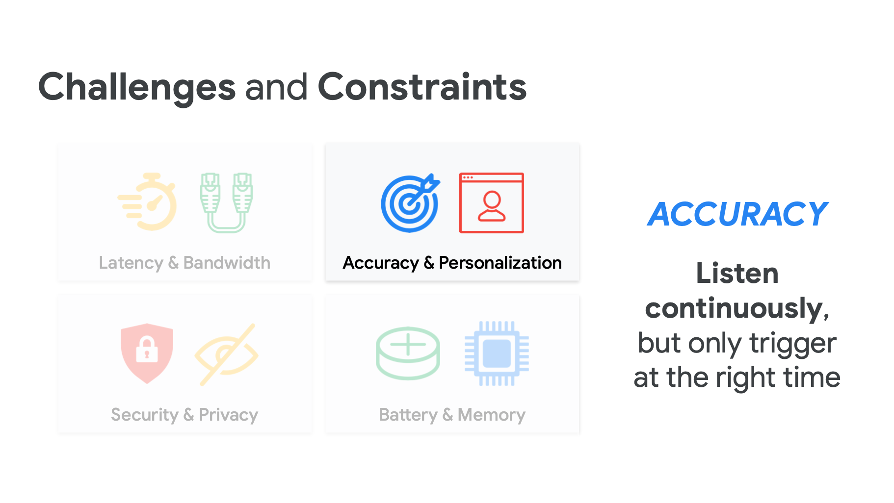

Slide 14
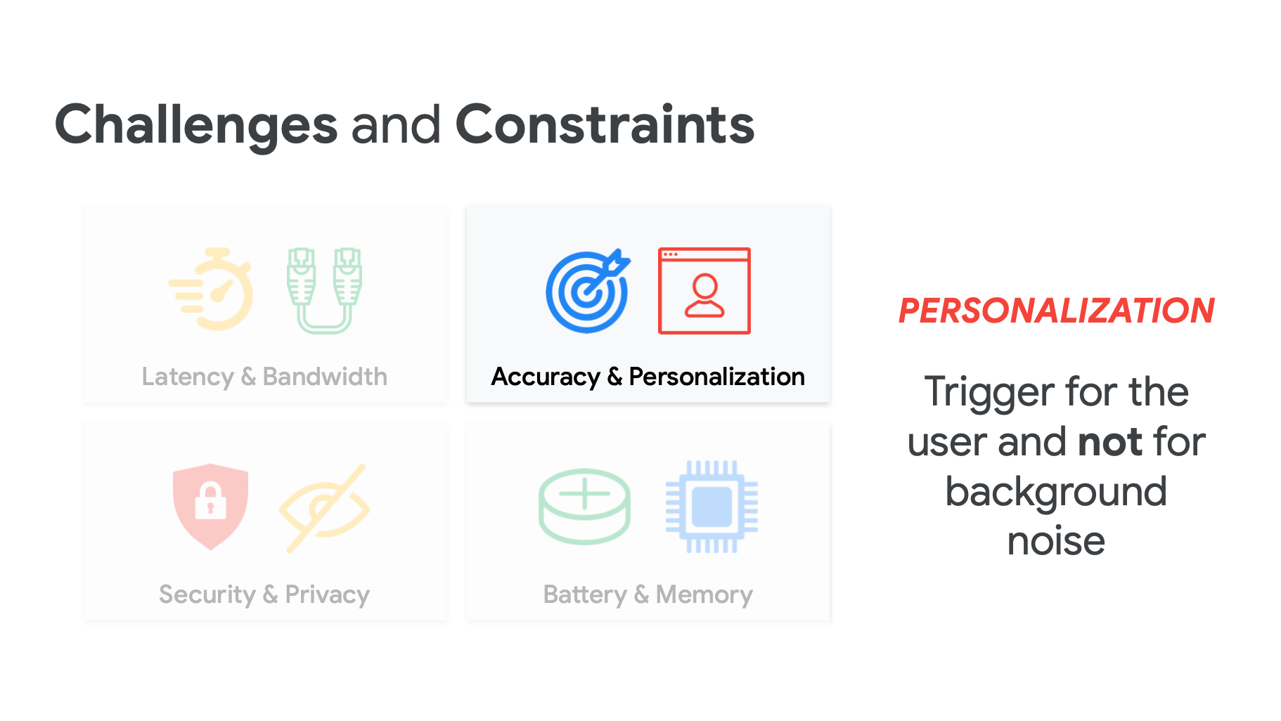

Slide 15


Slide 16


Slide 17
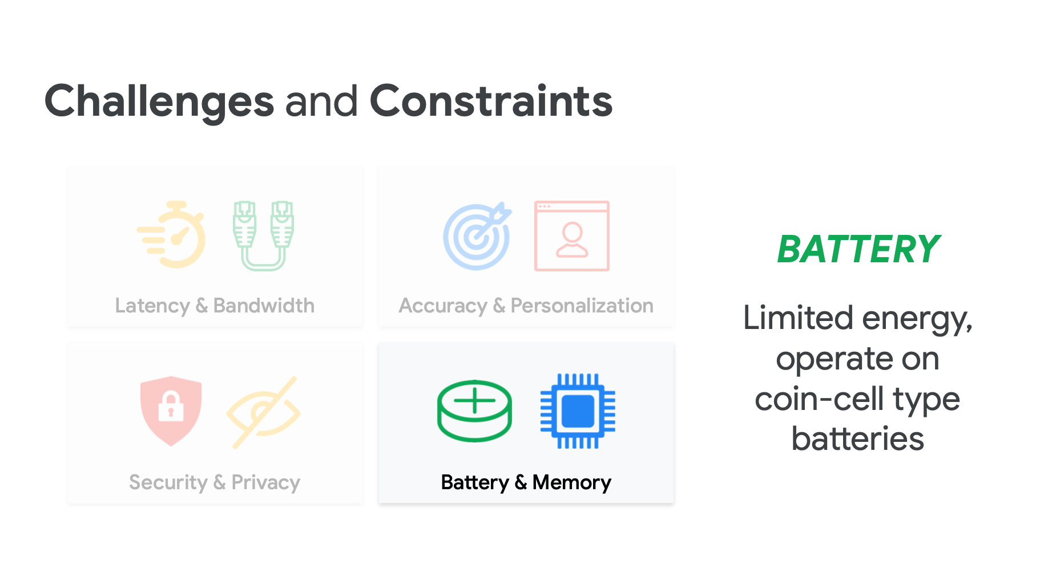

Slide 18
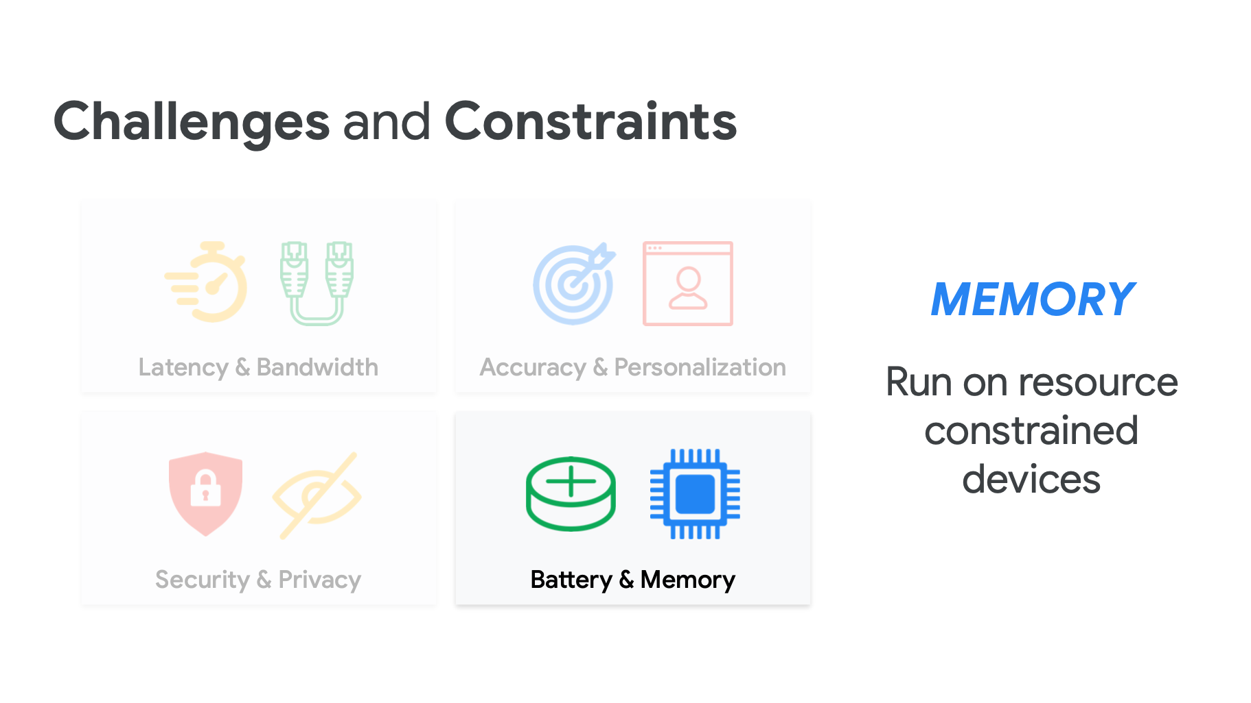

Slide 19
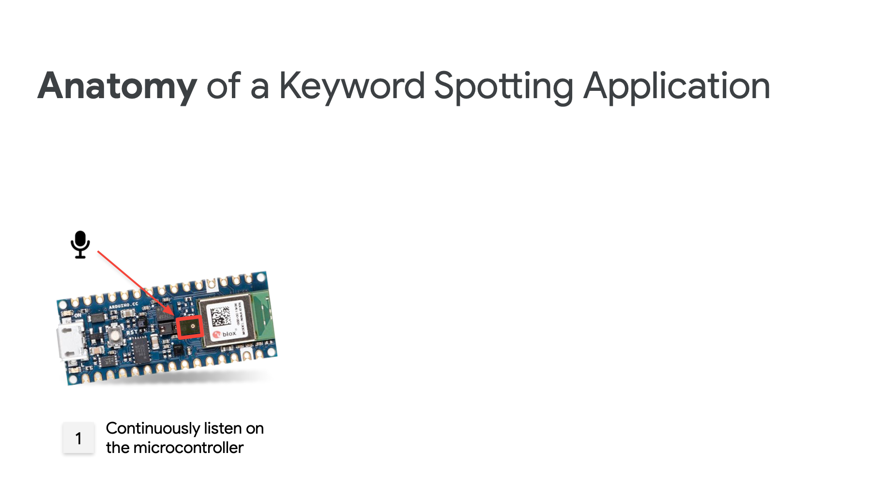

Slide 20
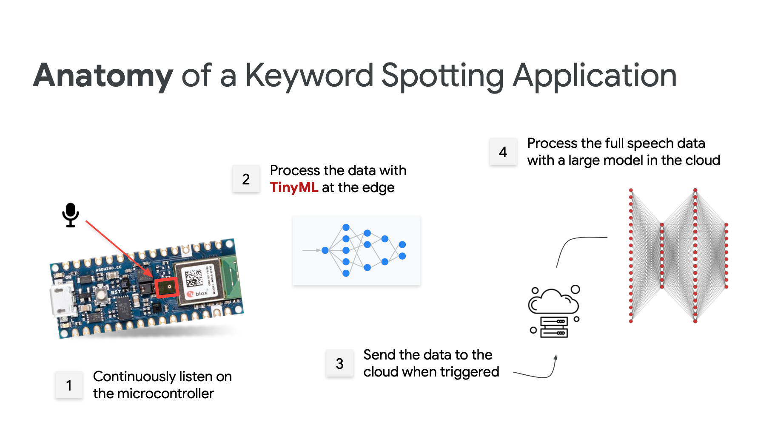

Slide 21
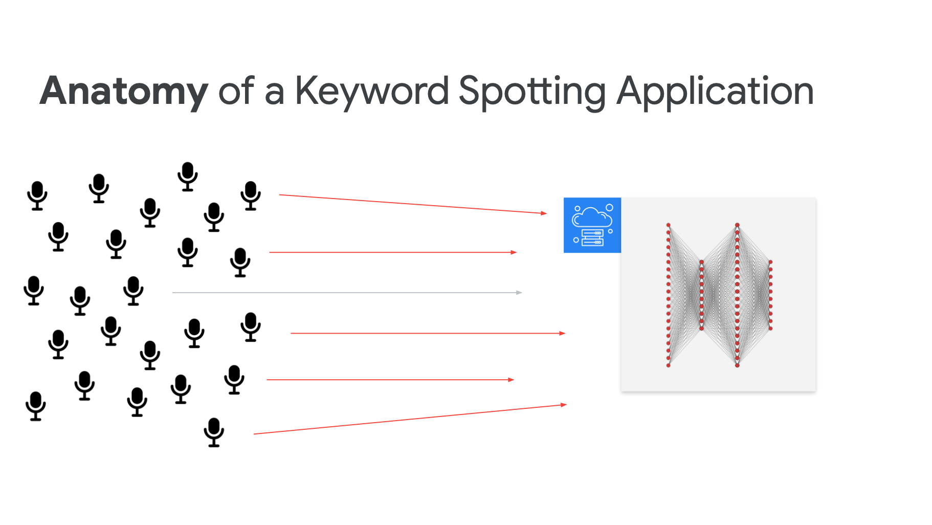

Slide 22
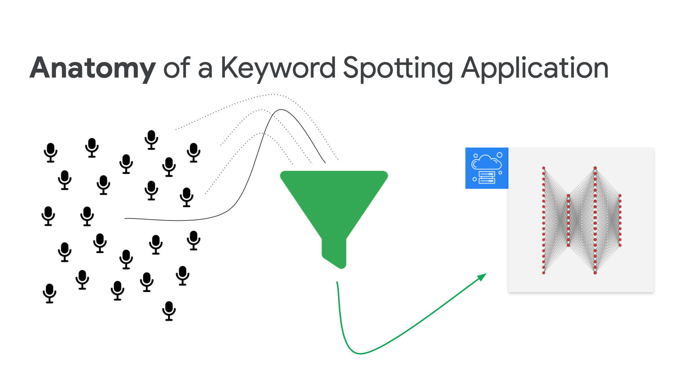

Slide 23
Keyword Spotting Datasets

Slide 24
How do we build a good dataset?
Who are the users?
What do they need?
What task are they trying to solve?
How do they interact with the system?
How does the real world make this hard?

Slide 25

https://arxiv.org/pdf/1804.03209.pdf

Slide 26
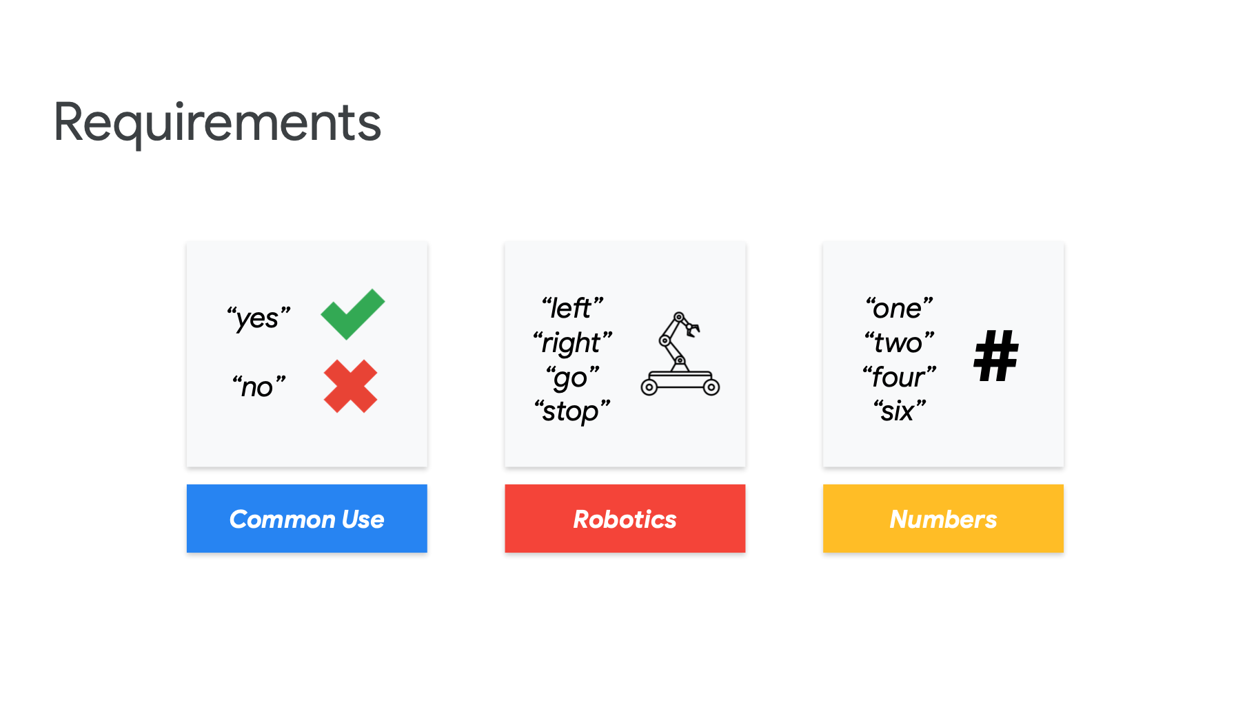

Slide 27
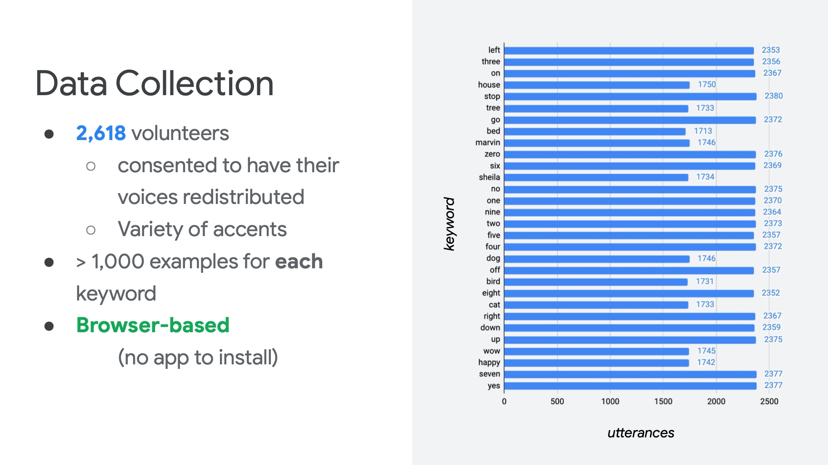

Slide 28
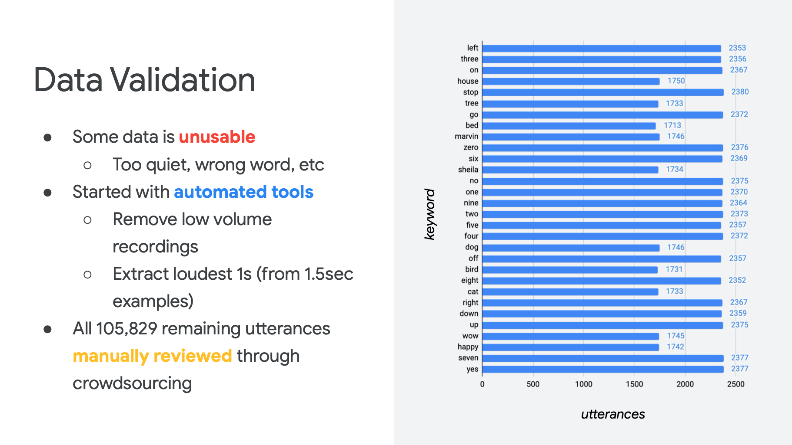

Slide 29
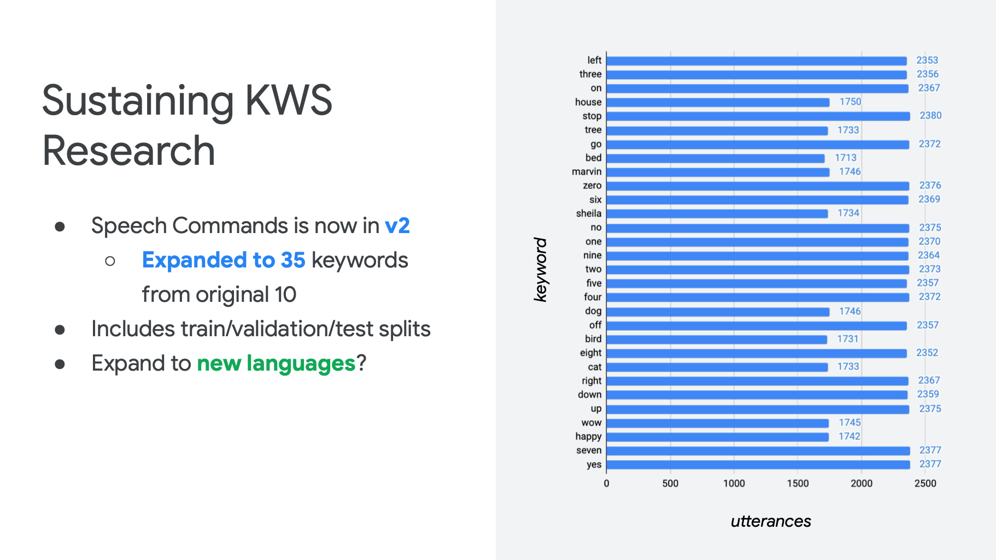

Slide 30

https://commonvoice.mozilla.org/en

Slide 31
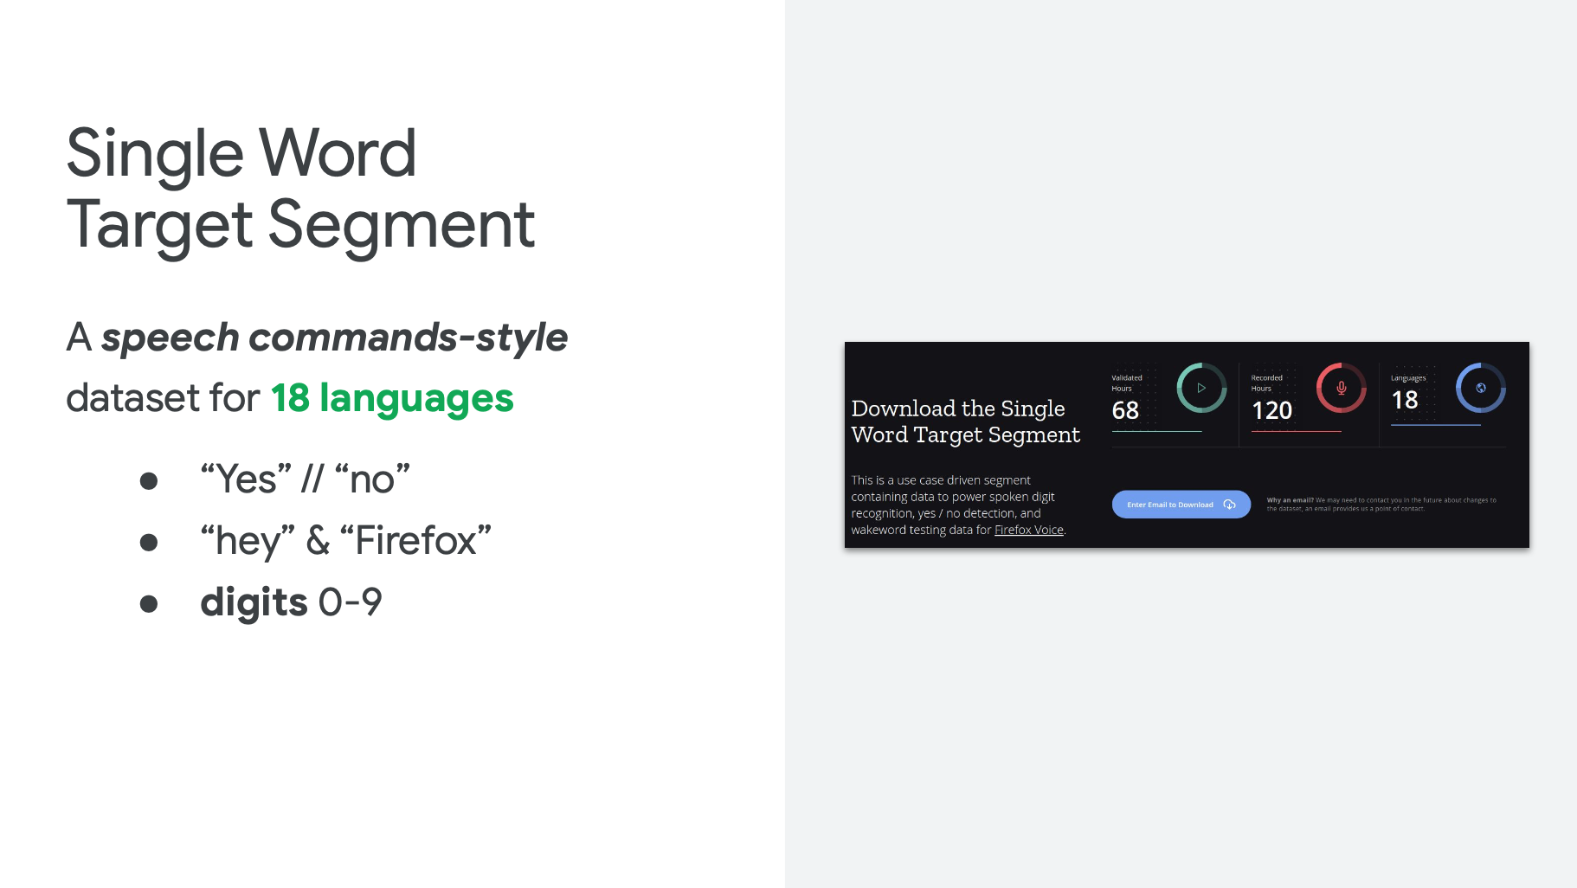
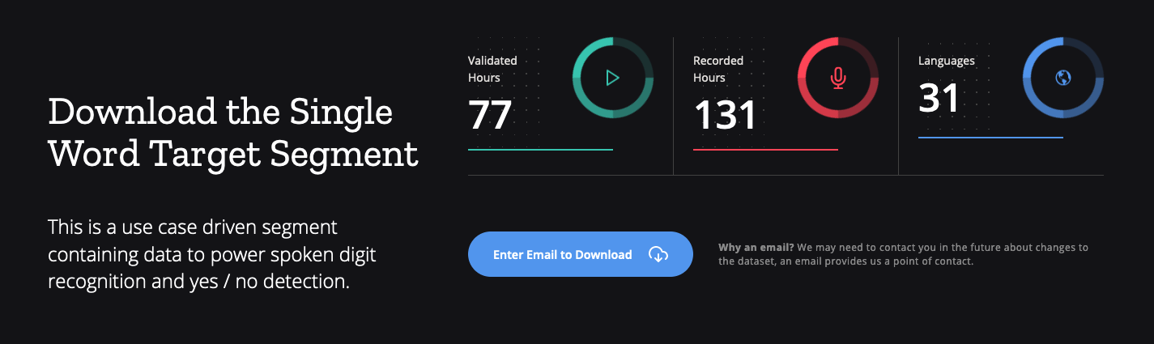
https://commonvoice.mozilla.org/en/datasets

Slide 32
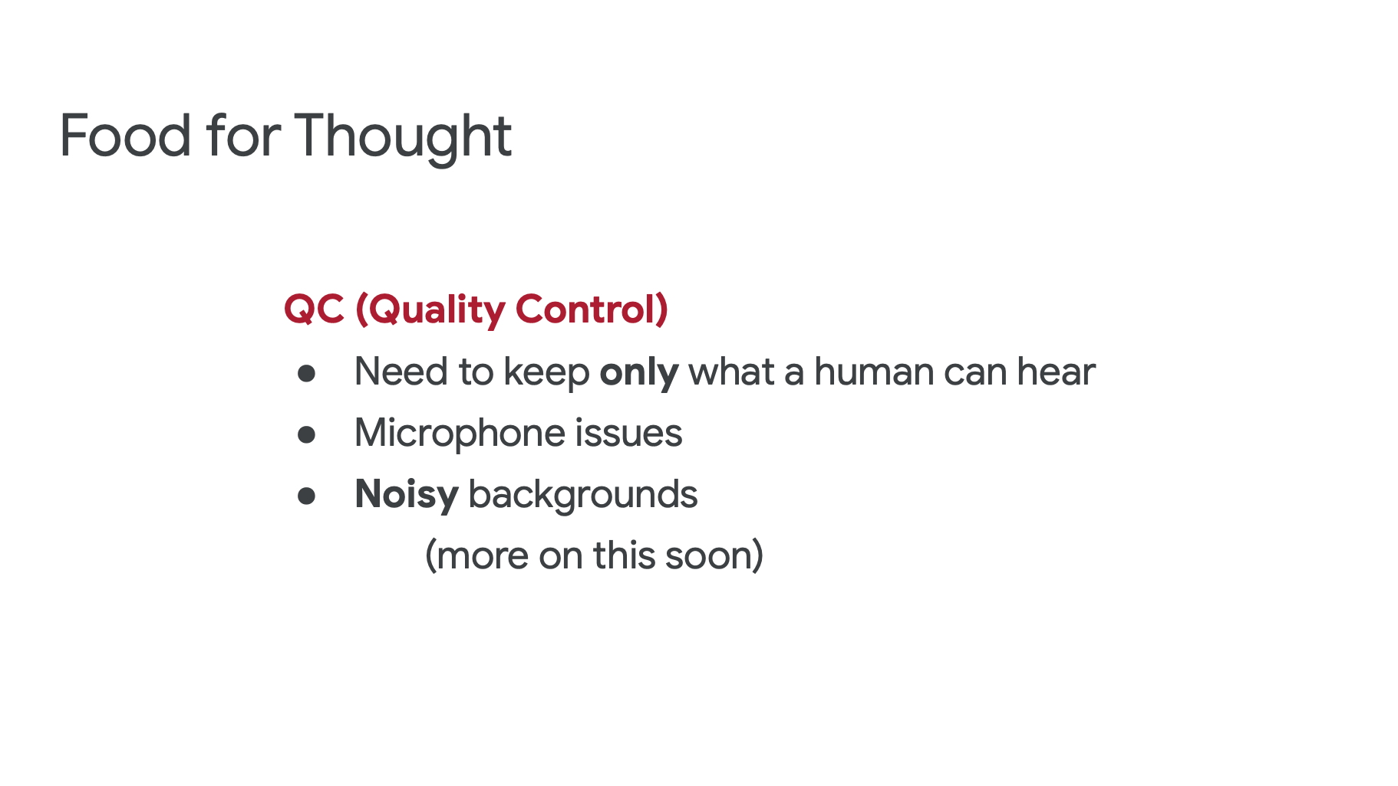

Slide 33
KWS Data Collection & Pre-Processing

Slide 34



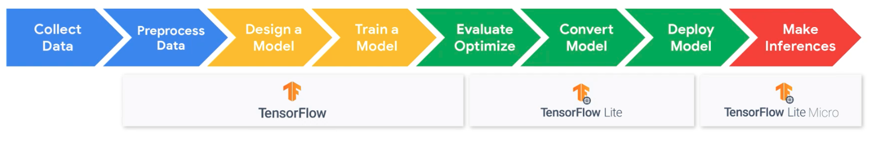
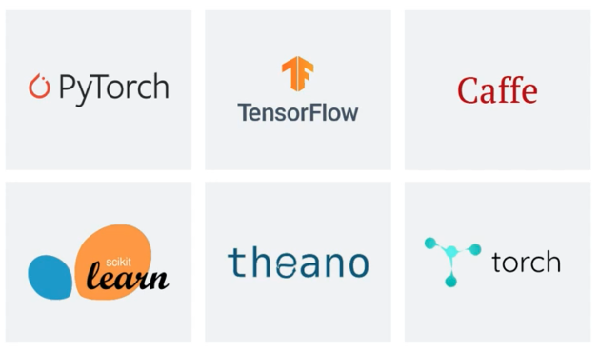
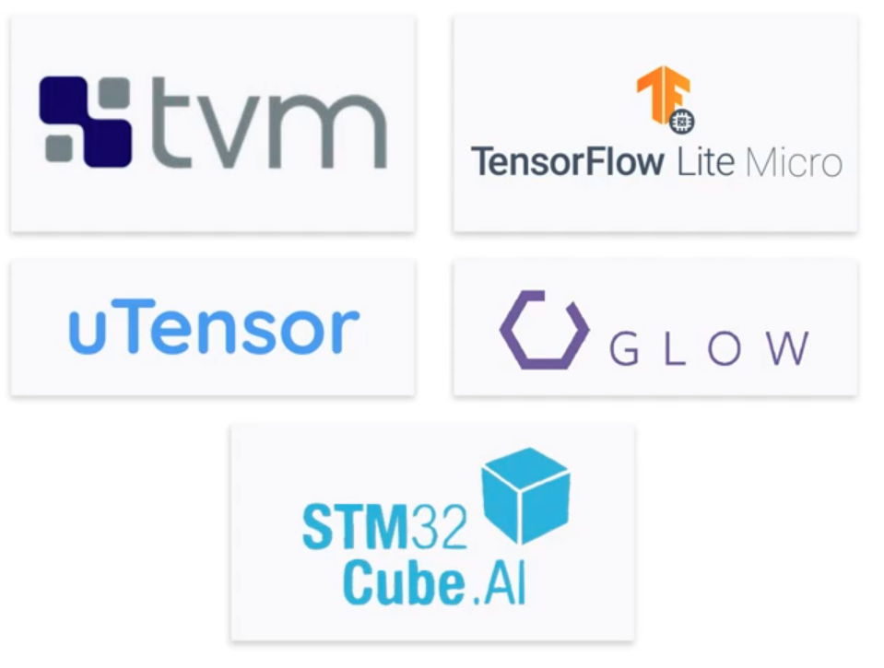

Data Engineering
Model Engineering
Model Deployment
Product Analytics

Slide 35
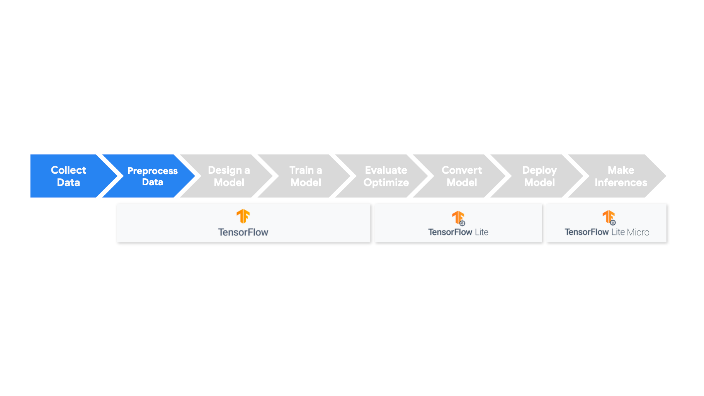

Slide 36
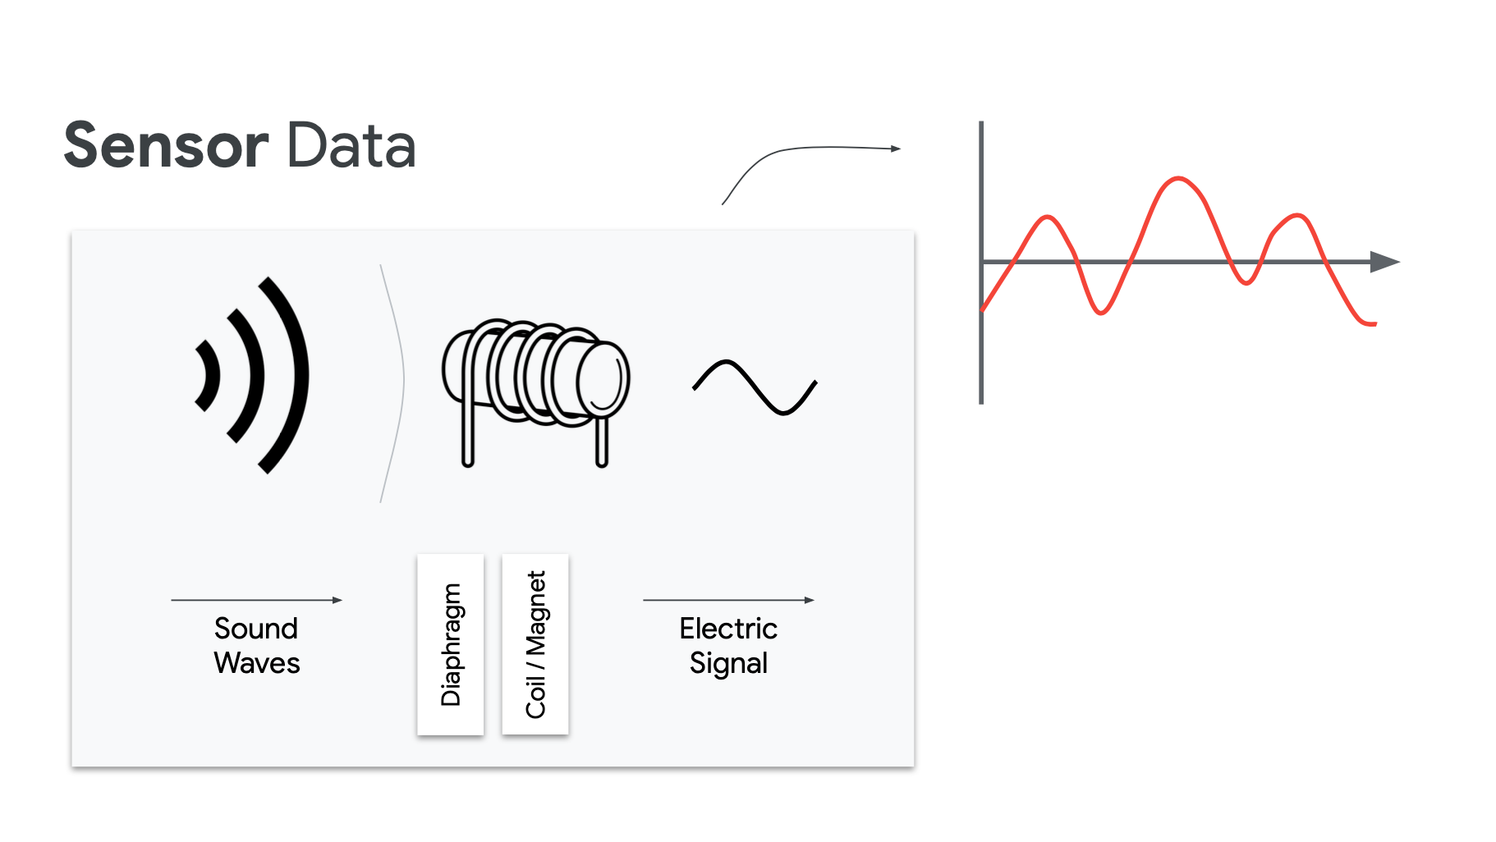

Slide 37
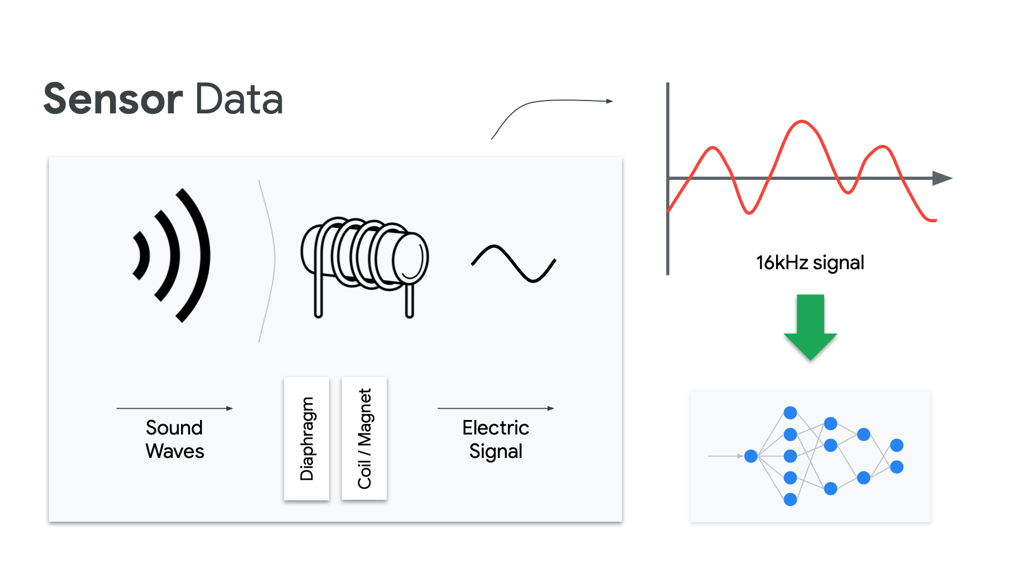

Slide 38
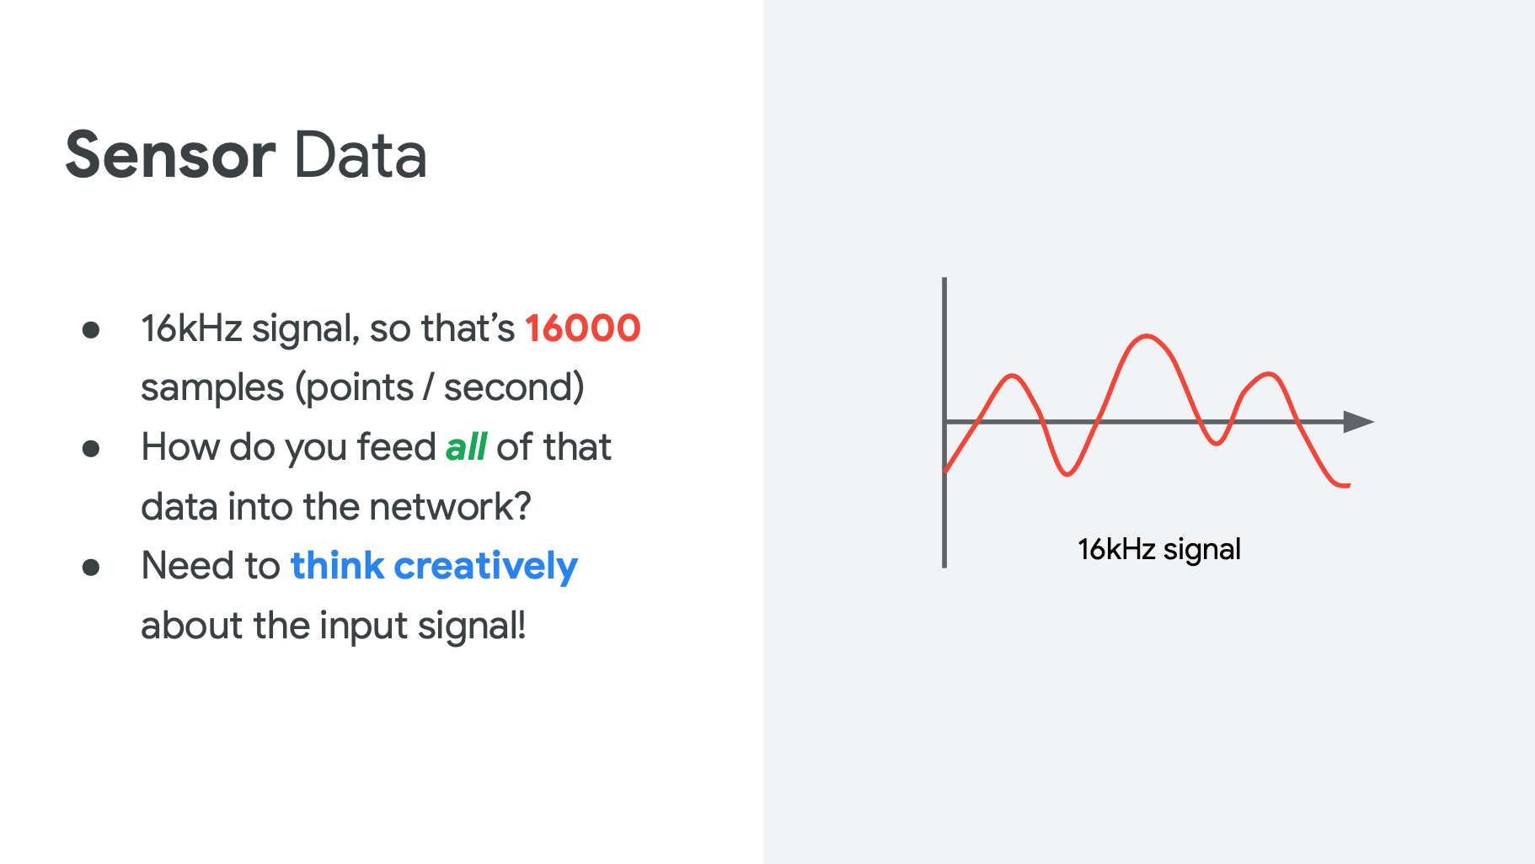

Slide 39
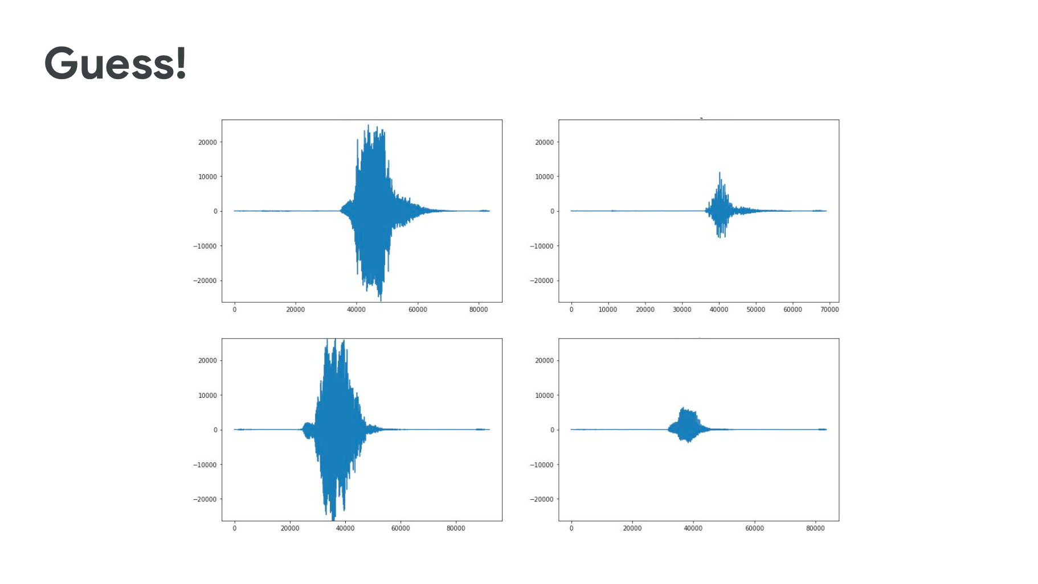

Slide 40
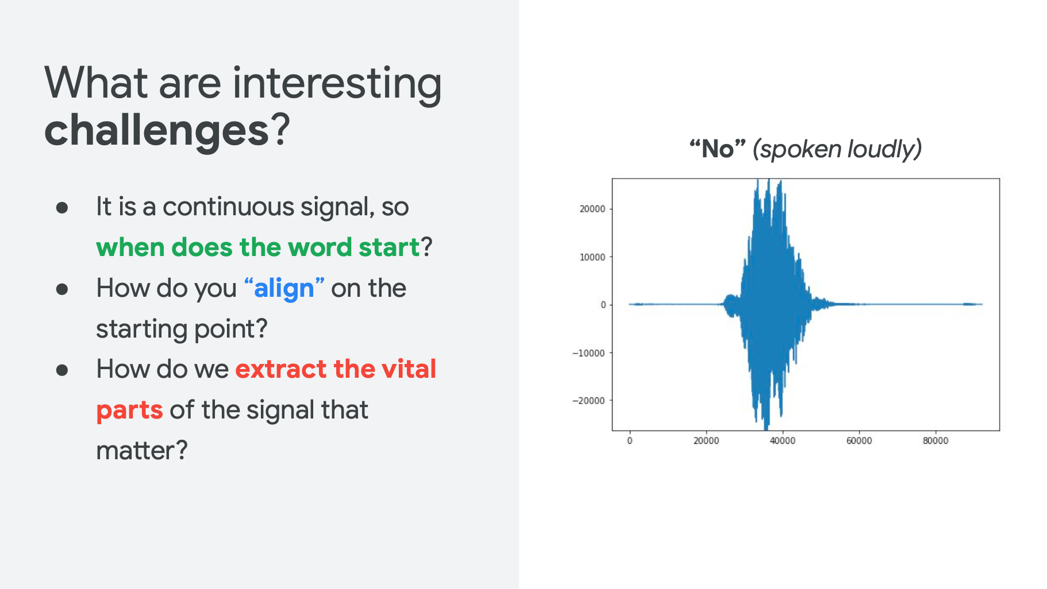

Slide 41
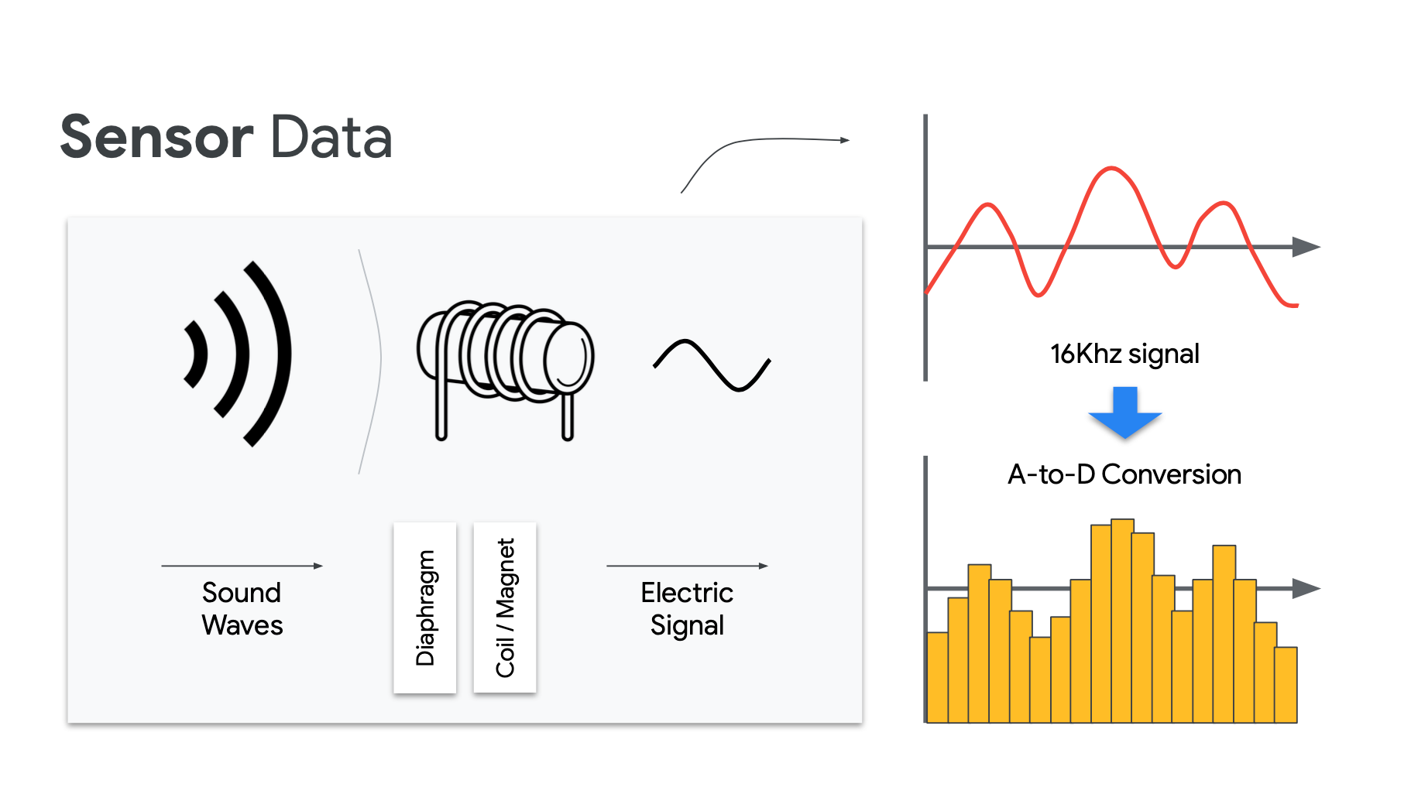

Slide 42
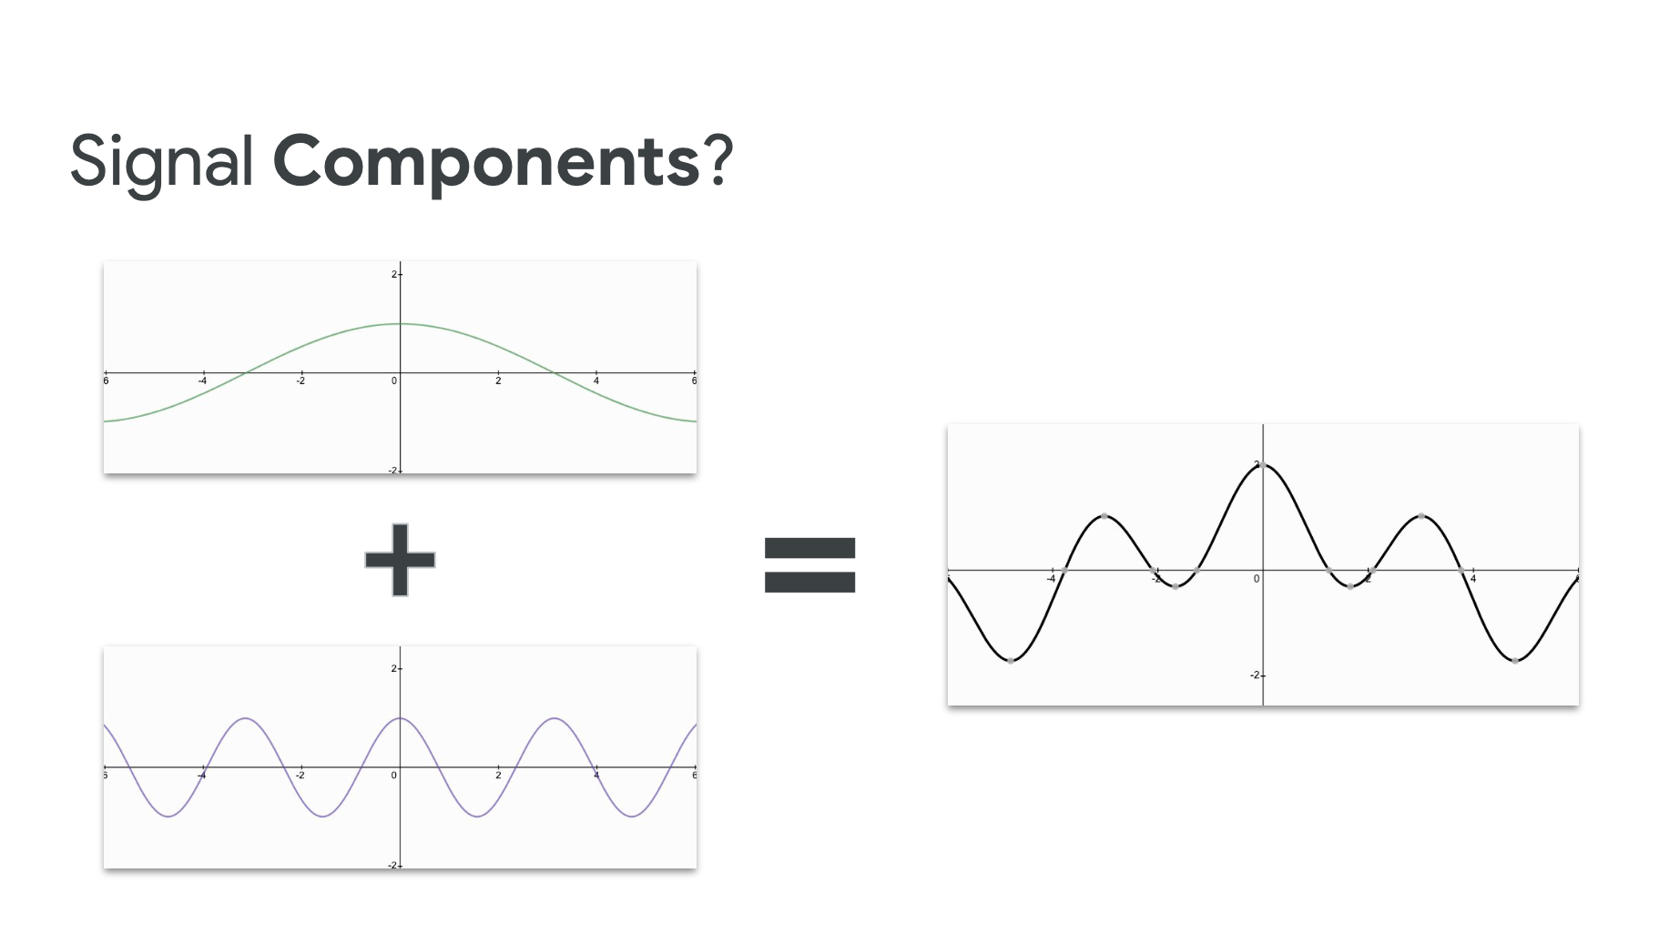

Slide 43
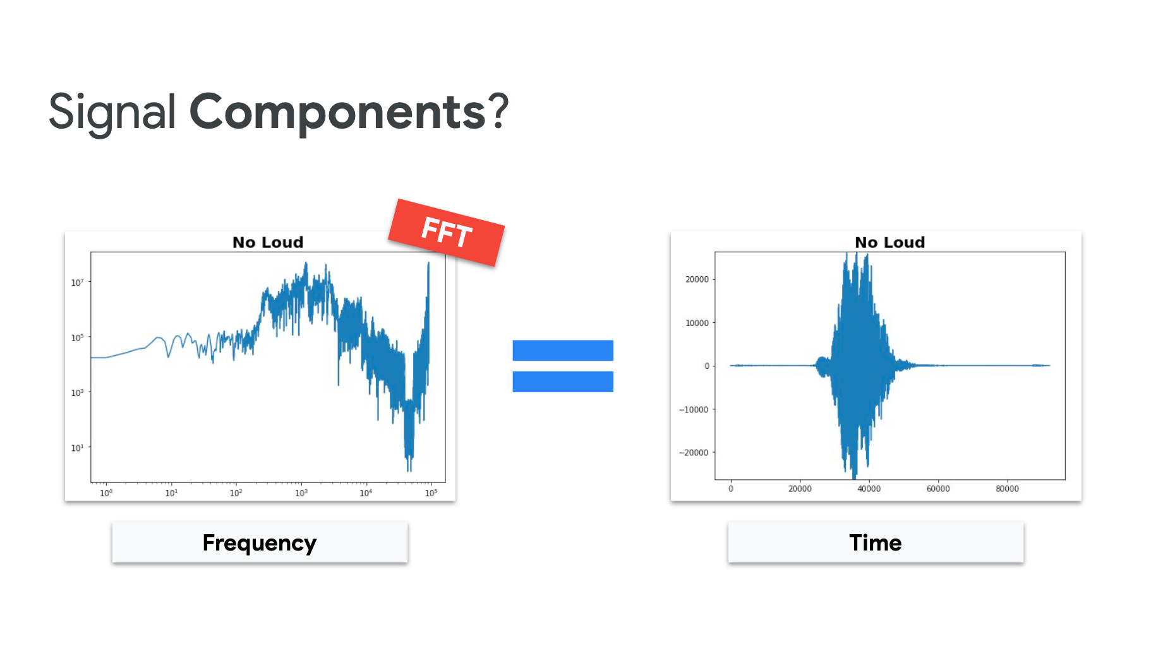

Slide 44
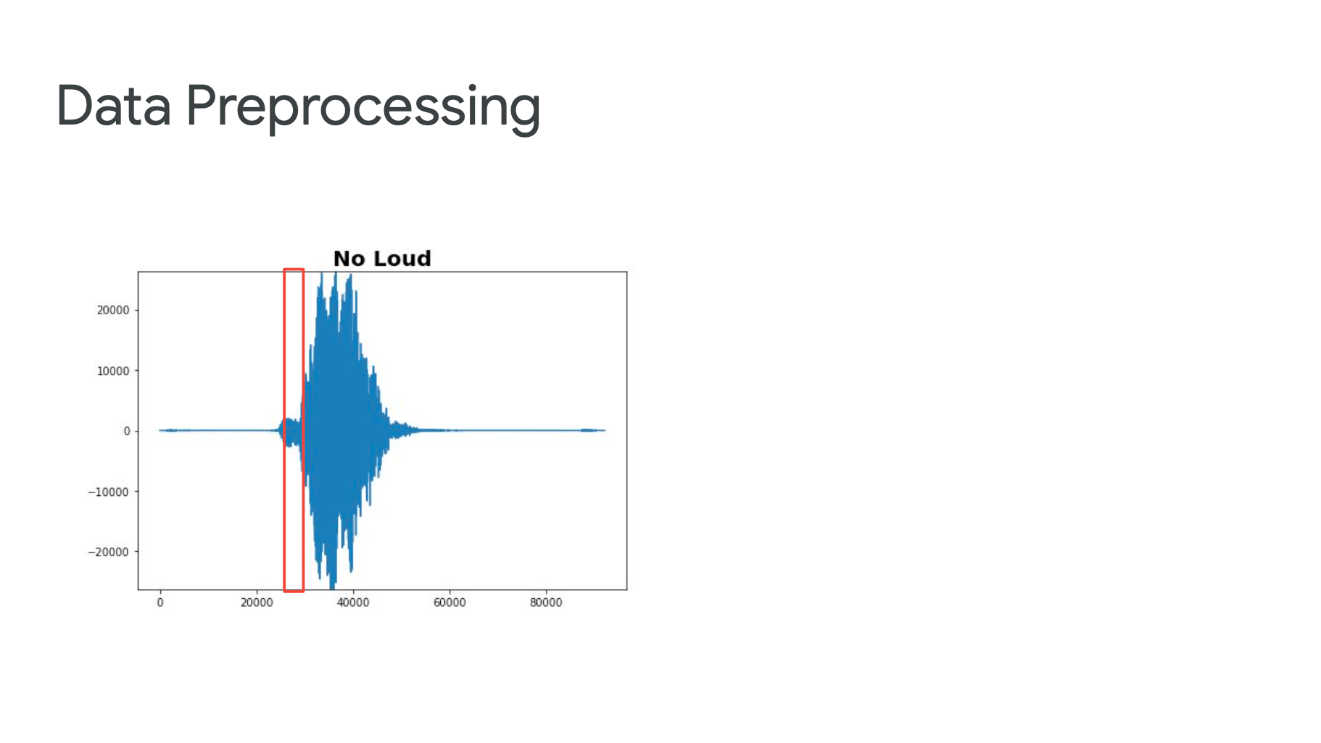

Slide 45


Slide 46
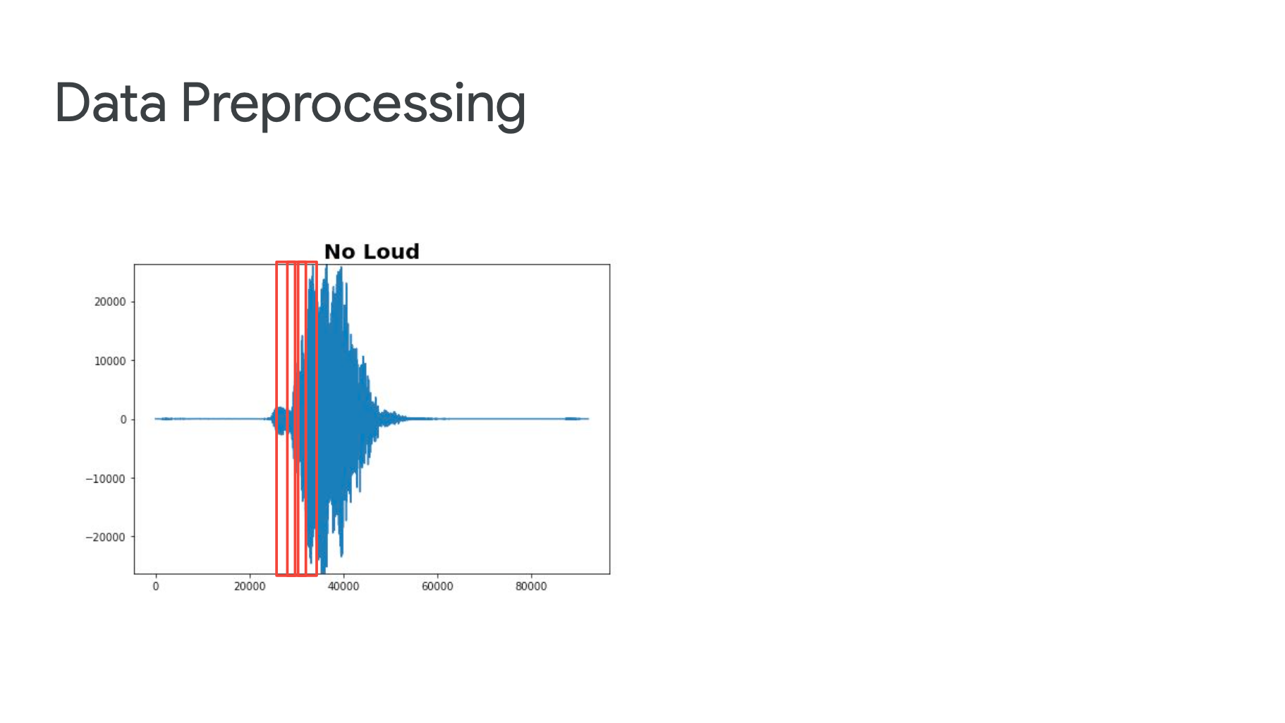

Slide 47
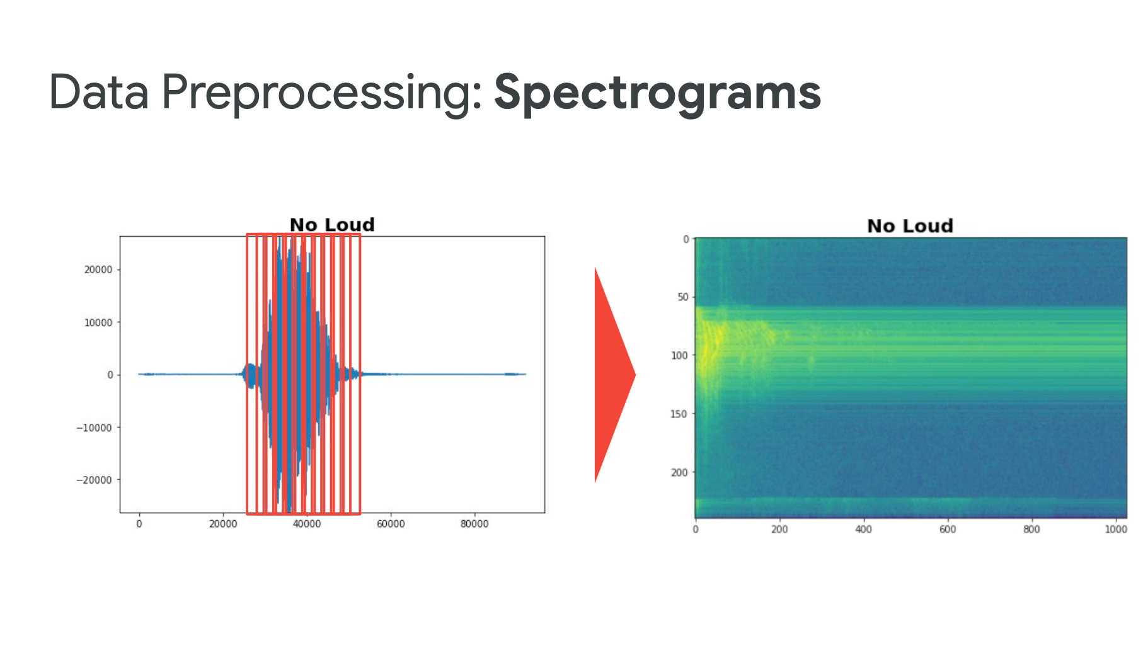

Slide 48
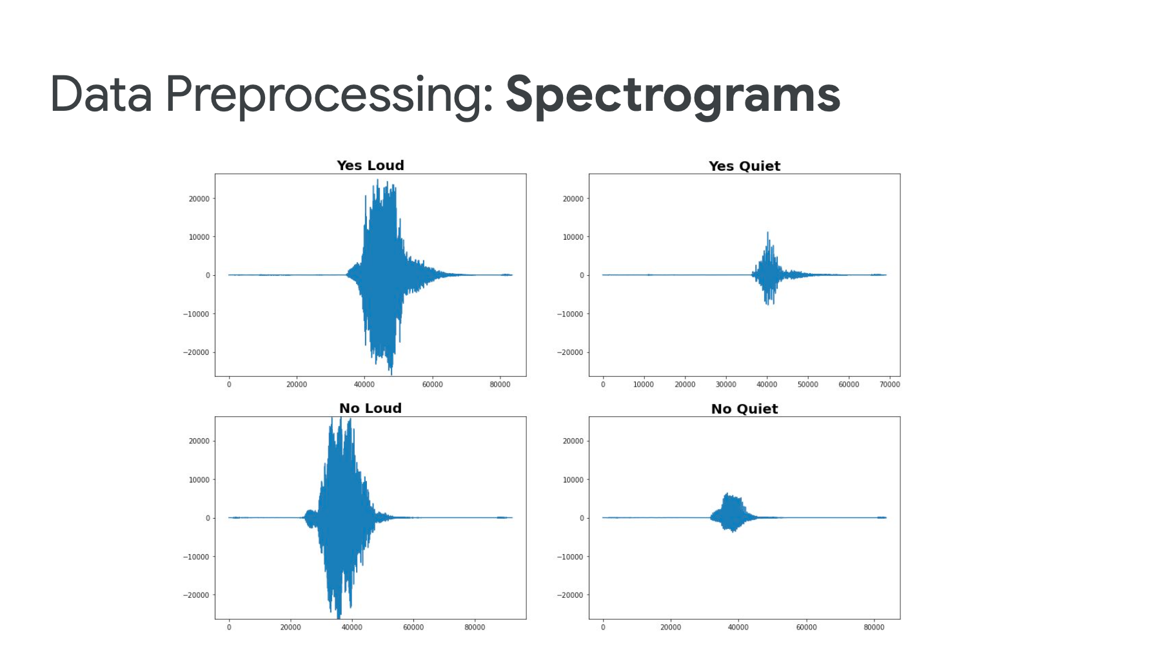

Slide 49
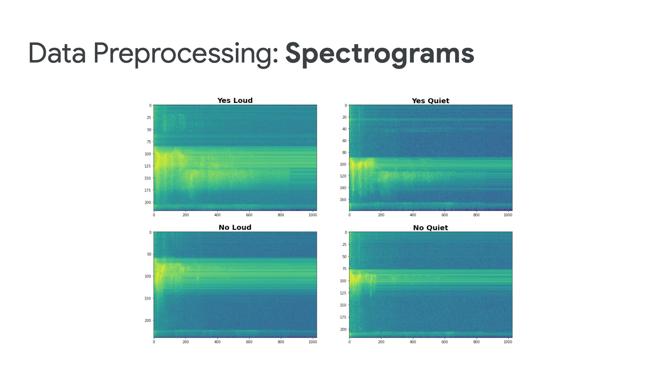

Slide 50
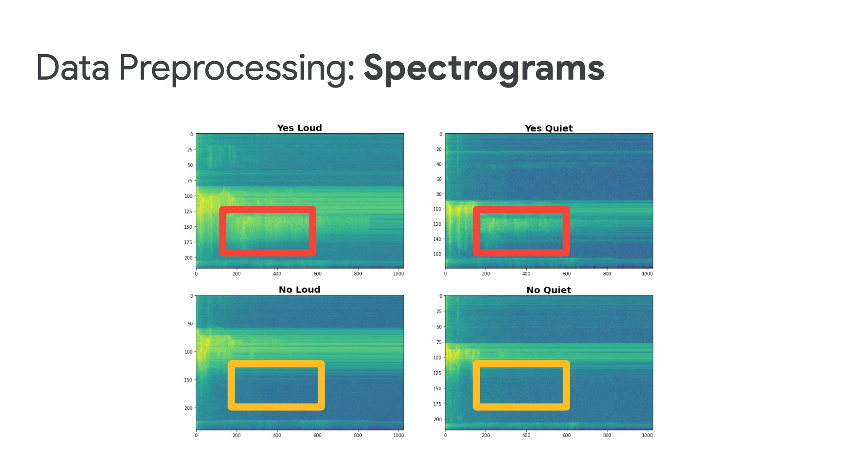

Slide 51
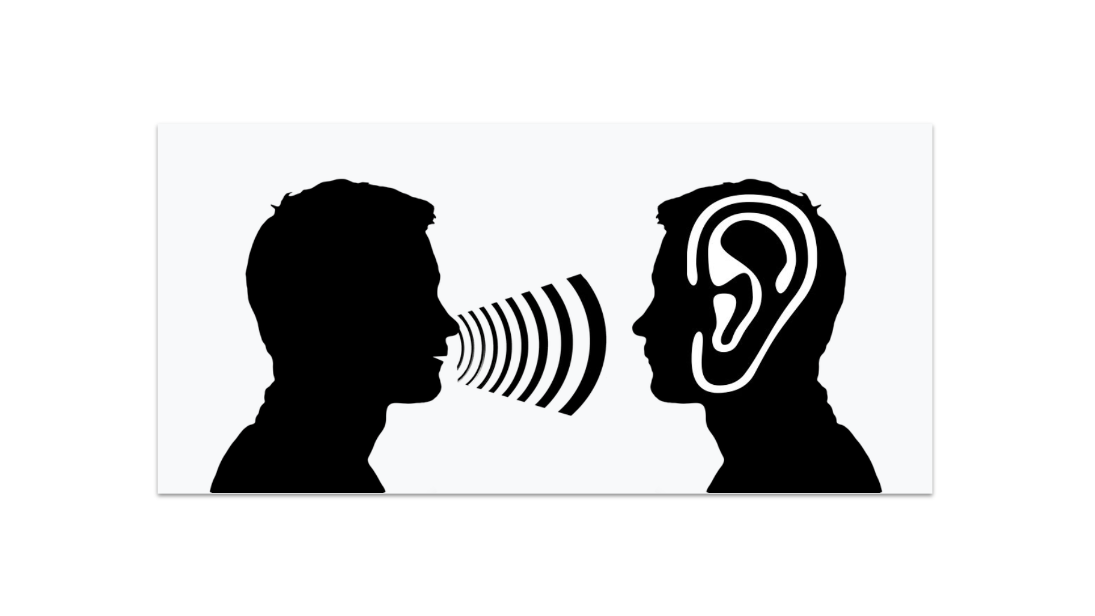
The lower band frequencies is much more crisper to us

Slide 52
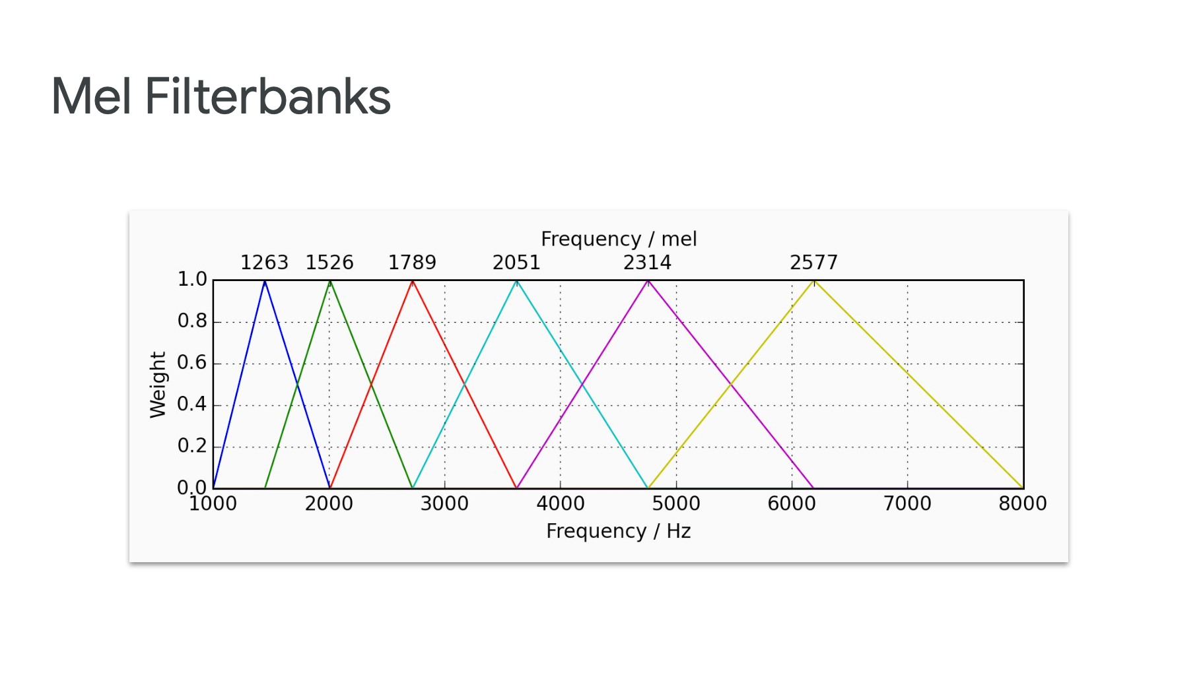

Slide 53
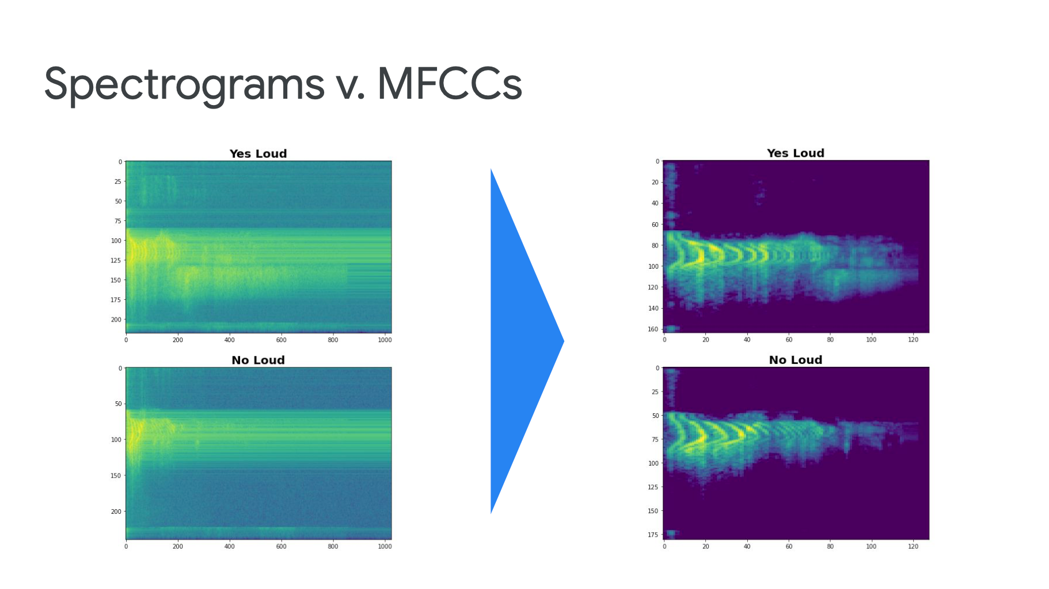

Slide 54
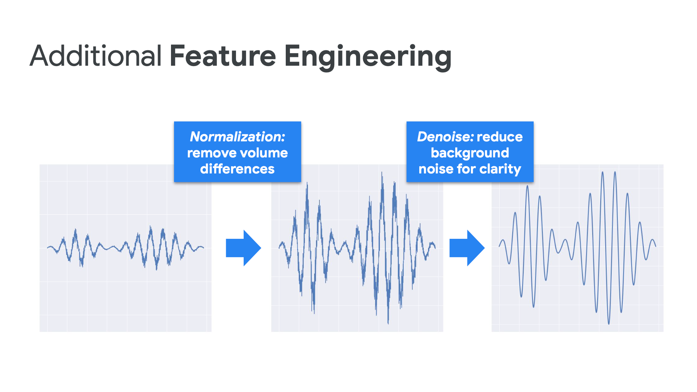

Slide 55


Spectrograms and MFCCs Code Time!
SpectrogramsMFCCs.ipynb

Slide 56
A Keyword Spotting Model

Slide 57
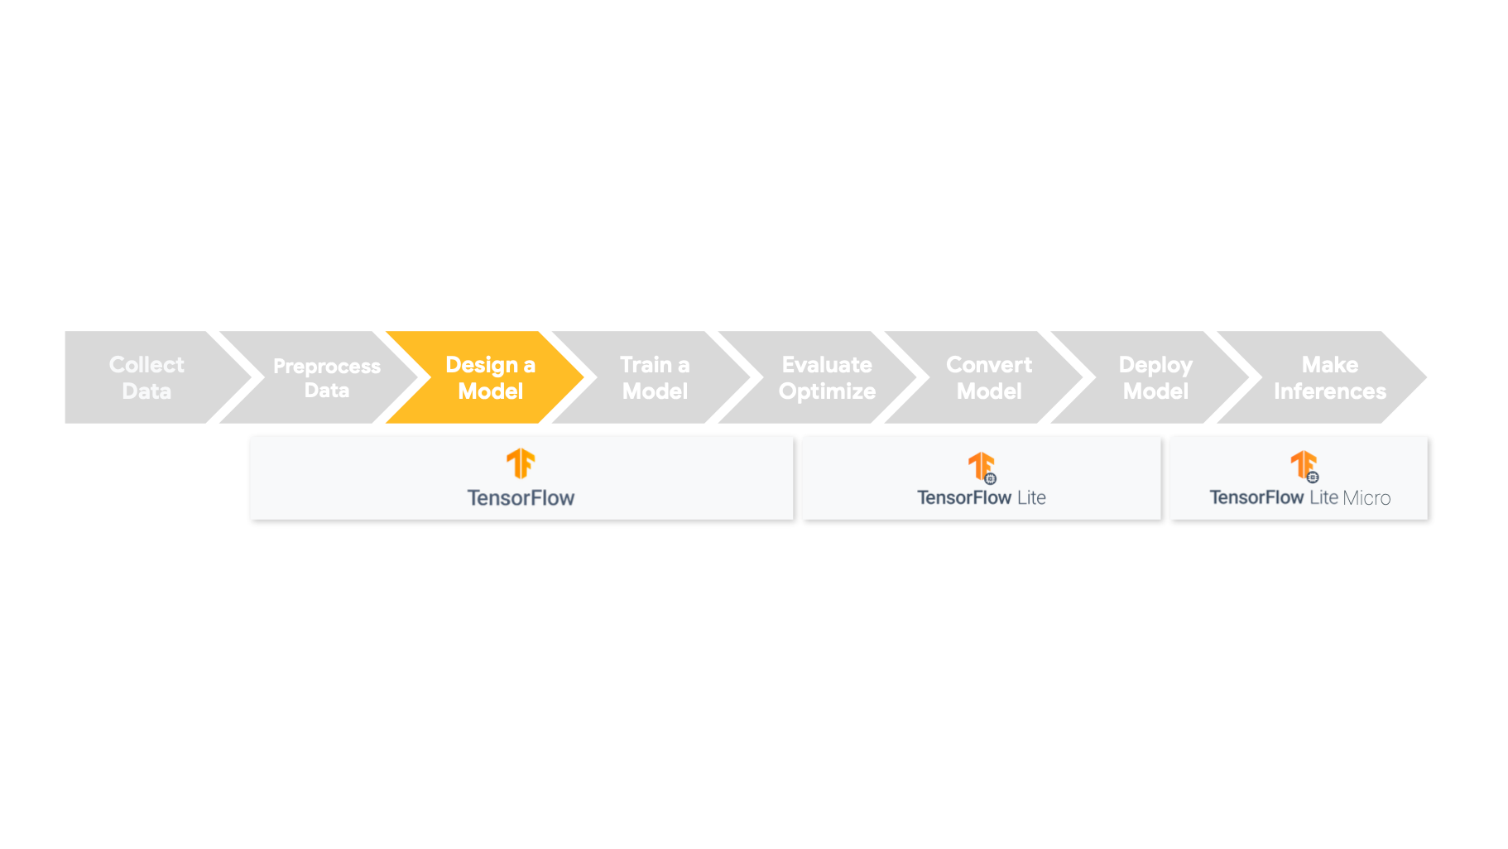

Slide 58
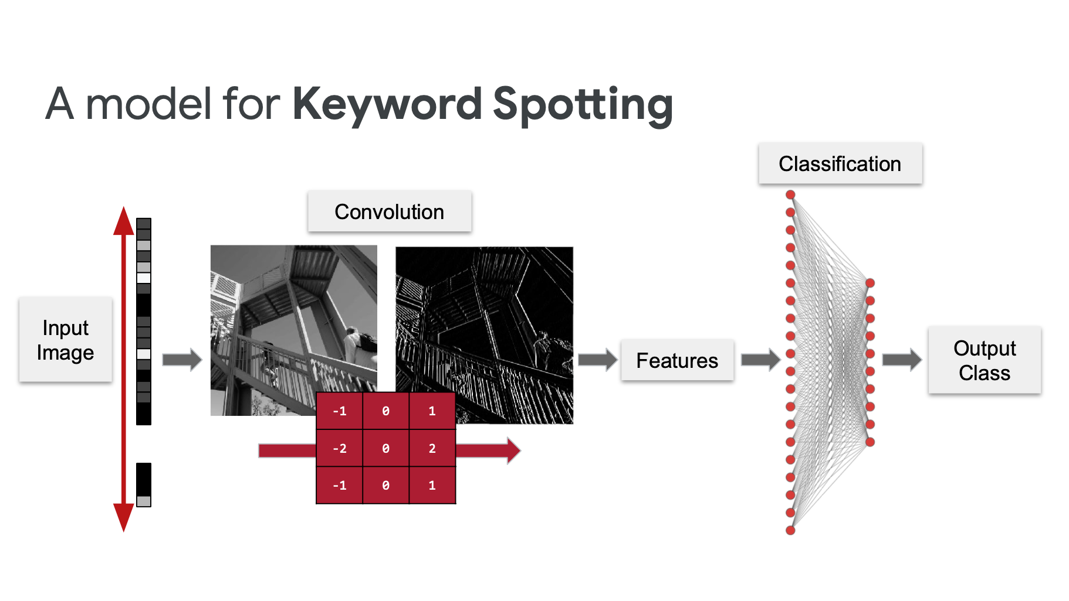

Slide 59
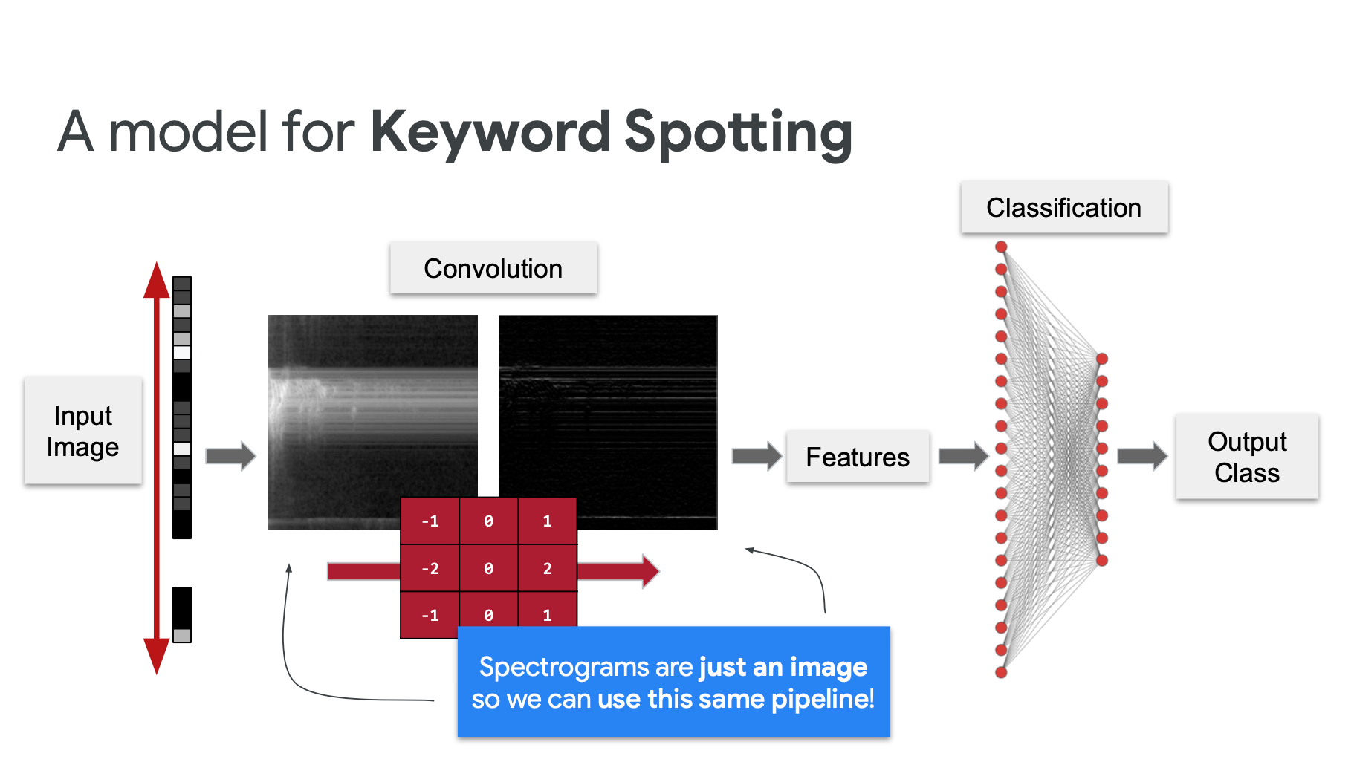

Slide 60
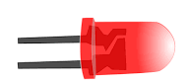






KeyWord Spotting (KWS) - Inference
Make things happen
Obtains an input
Pre-Process
Runs model
postprocesses
“UNIFEI”
Digital Mic
MFCC Feature
Converter
UNIFEI
16KHz / 16 bits
Sample: [1s]
Output: Image
[13, 50, 1]
IESTI
Output Dim [1, 3]
Prob ‘iesti’
Prob ‘unifei’
Prob ‘silence’
Check the highest probability
Take actions
https://youtu.be/XnFYz-RSNe8

Slide 61




KeyWord Spotting (KWS) – Create Model (Training)
Obtains data
Pre-Process
Train model
Evaluate Model
Convert / Deploy
Digital Mic
MFCC Feature
Converter
16KHz / 16 bits
Sample: [1s]
Output: Image
[13, 50, 1]

Slide 62


“UNIFEI”
13 x 50 = 650

Slide 63



Mo
Arduino Nano-33
Model size: 200KB

Slide 64
Arduino Nano-33

Slide 65


Arduino Nano-33

Slide 66


12 KB

Slide 67
Reading Material

Slide 68
Main references
Harvard School of Engineering and Applied Sciences - CS249r: Tiny Machine Learning
Professional Certificate in Tiny Machine Learning (TinyML) – edX/Harvard
Introduction to Embedded Machine Learning (Coursera)
Text Book: "TinyML" by Pete Warden, Daniel Situnayake
I want to thank Shawn Hymel and Edge Impulse, Pete Warden and Laurence Moroney from Google, and especially Harvard professor Vijay Janapa Reddi, Ph.D. student Brian Plancher and their staff for preparing the excellent material on TinyML that is the basis of this course at UNIFEI.
The IESTI01 course is part of the TinyML4D, an initiative to make TinyML education available to everyone globally.

Slide 69

Thanks
And stay safe!

